Slide 1
Food and Nutritional Security, Nutrition Strategies and Policies
Selamawit M (PhD)

Slide 2
Food security
Food self sufficient
Nutrition security

Slide 3
Introduction
Definition
  Food security was defined in the 1974 World Food Summit as:
    “Availability at all times of adequate world food supplies of basic foodstuffs to sustain a steady expansion of food consumption and to offset fluctuations in production and prices”

Slide 4
In 1983, FAO expanded its concept to include securing access by vulnerable people to available supplies, implying that attention should be balanced between the demand and supply side of the food security equation:
  “Ensuring that all people at all times have both physical and economic access to the basic food that they need”

Slide 5
In 1986, the highly influential World Bank report “Poverty and Hunger” focused on the temporal dynamics of food insecurity.
It introduced the widely accepted distinction between chronic food insecurity, associated with problems of continuing or structural poverty and low incomes, and transitory food insecurity, which involved periods of intensified pressure caused by natural disasters, economic collapse or conflict.
This concept of food security is further elaborated in terms of:
“Access of all people at all times to enough food for an active, healthy life”.

Slide 6
By the mid-1990s
  Definition was broadened to incorporate food safety and also nutritional balance, reflecting concerns about food composition and minor nutrient requirements for an active and healthy life
  The potentially high degree of context specificity implies that the concept had both lost its simplicity and was not itself a goal, but an intermediating set of actions that contribute to an active and healthy life

Slide 7
The 1994 UNDP Human Development Report
  Promoted food security as a concept closely related to the human rights perspective on development.
  Focused on a wider construct of social security which has many distinct components including, of course, health and nutrition.

Slide 8
The 1996 World Food Summit adopted a still more complex definition:
  “Food security, at the individual, household, national, regional and global levels is achieved when all people, at all times, have physical and economic access to sufficient, safe and nutritious food to meet their dietary needs and food preferences for an active and healthy life”

Slide 9
Definition
This definition is again refined in The State of Food Insecurity 2001:
  “Food security is a situation that exists when all people, at all times, have physical, social and economic access to sufficient, safe and nutritious food that meets their dietary needs and food preferences for an active and healthy life”

Slide 10
Food security exists
  When all people, at all times, have physical, social and economic access to sufficient, safe and nutritious food which meets their dietary needs and food preferences for an active and healthy life.
Food insecurity exists
  When people do not have adequate physical, social or economic access to food as defined above

Slide 11
Food security vs. Food Self Sufficiency
Food security
  Being able to get adequate and sufficient food, regardless of where it comes from
  These days, it comes from all over the world. We are able to buy food from all over the world because we have the money to purchase the food
Food self-sufficiency
  In contrast , food self-sufficiency is defined as being able to meet consumption needs (particularly for staple food crops) from own production rather than by buying or importing.

Slide 12
Nutrition security
  Access of all people at all times to sufficient food, including adequate utilization and absorption, in order to be able to live a healthy and active life.
  Adequate Utilization refers to the ability of the human body to ingest and metabolize food.
    Nutritious and safe diets, an adequate biological and social environment, a proper health care to avoid diseases ensure adequate utilization of food.

Slide 13
  A household achieves nutrition security when it has secure access to food coupled with a sanitary environment, adequate health services and knowledgeable care to ensure a healthy life for all household members

Slide 14
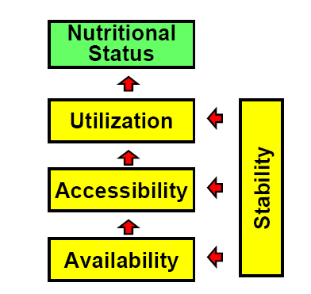
The Conceptual Framework of Food and Nutrition Security

Slide 15
Two determinants influence the framework:
  Physical determinant
  Temporal determinant

Slide 16
Physical determinant is the food flow
  Availability → Accessibility → Utilization
  Availability is achieved if adequate food is ready to have at people’s disposal
  Access is ensured when all households and all individuals within those households have sufficient resources to obtain appropriate foods (through production, purchase or donation) for a nutritious diet
  Adequate Utilization refers to the ability of the human body to ingest and metabolize food.
    Nutritious and safe diets, an adequate biological and social environment, a proper health care to avoid diseases ensure adequate utilization of food.

Slide 17
The temporal determinant
  Stability refers to the temporal determinant of FNS and affects all three physical elements
    Chronic food and nutrition insecurity due to
      Repeated food shortages before harvest “seasonality”
      Lack of caring during harvest
    Transitory food and nutrition insecurity due to
      Natural disasters
      Man made disasters

Slide 18
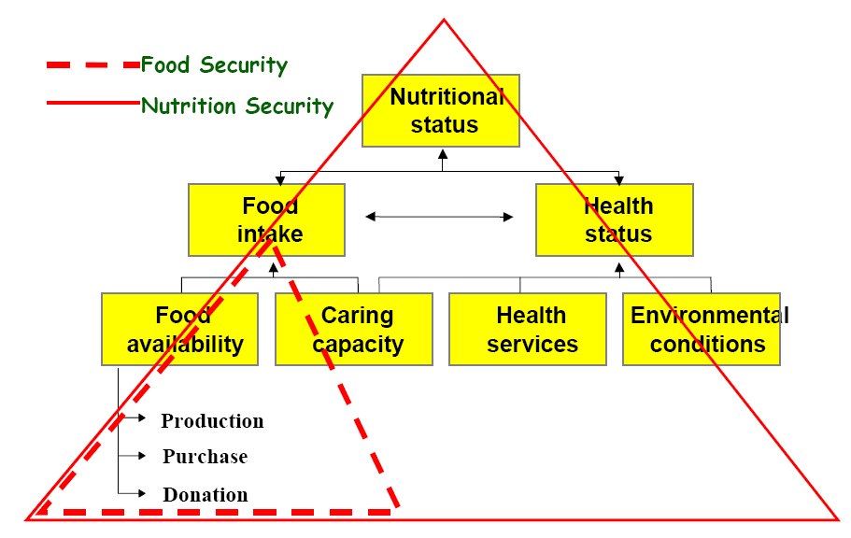
Conceptual frame work

Slide 19
Conceptual frame work cont…
This conceptual framework for nutritional status emphasizes the difference between ‘Food Security‘ and ‘Nutrition Security.’
  The first refers to the area of causes and effects of food availability
    Illustrated as the small, dotted triangle
  The latter refers to the entire relationships
    Depicted in the large, lined triangle.

Slide 20
Conceptual frame work cont…
The two most commonly used conceptual frameworks show significant differences
  The food security framework emphasizes an economic approach in which food as a commodity is a central focus
  The nutrition security framework adopts a biological approach in which the human being is the starting point

Slide 21
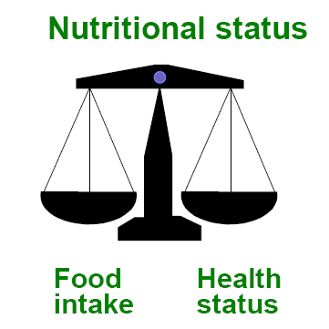
Conceptual frame work cont…
The conceptual framework of FNS integrates the food security and the malnutrition frameworks
However
  Both frameworks promote an interdisciplinary approach to ensuring FNS in common
  Both acknowledge that food alone is not sufficient to secure a sustainable satisfactory nutritional status and, therefore, aspects of health must be considered

Slide 22
Therefore, What should be the FNS intervention programs?

Slide 23
Interventions for FNS
Suggested interventions to increase food security include
  Providing credit and inputs for farming such as agricultural starter packs;
  Making available low-interest loans for farmer support program
  Developing irrigation schemes
  Improving management of natural resources and the environment
  Providing community grain storage, processing facilities, and access to community agricultural transport services
  Improve access to household water and sanitation
  Increasing access to land and land tenure
  Implementing price controls and subsidies for food.

Slide 24
  Improve access to
    Antiretroviral vaccines, as well as treatment of other communicable diseases
    Health facilities
    Enriched feeding schemes for infants, pregnant women and the elderly
    Training in areas like food preparation, hygiene, child care, water and sanitation, and diet diversity
  Consolidating access to social grants, especially for child support and old age
  Providing food subsidies in chronic need situations

Slide 25
  Developing a low-interest loan scheme for high-risk periods and in disaster recovery program
  Develop and improve local markets for selling and buying food (giving households not only better access to food but opportunities to sell their excess produce for income)
  Improve road infrastructure, transport and access to electricity and free basic services
  Launch development initiatives to help generate incomes

Slide 26
  Offer incentives for developing local business and industry
  Outline local job markets and fund skills development initiatives, perhaps in partnership with local companies.
  Consolidate school feeding program and develop a way to minimize the burden households face every September when they must pay for school fees, uniforms and other school needs.

Slide 27
The three characteristics of a FNS Program
FNS program has to meet three requirements.
  The most nutritional vulnerable people are addressed (adequate targeting)
    FNS program must be targeted to reach the most nutritional vulnerable population groups
    Malnutrition is most prevalent in the poorest segment of society
    However, FNS is not identical to poverty alleviation since poverty is far more comprehensive than malnutrition

Slide 28
  Proper design
    The selected interventions are based on the identified nutritional problems of the target group and the available resources
    The interventions selected should be based on the specific program strategy that addressed the identified nutritional problems of the malnourished target groups
    This requires a careful quantitative and qualitative diagnosis of the nature, magnitude, causes and effects of the problems

Slide 29
  High effectiveness and efficiency
    The interventions can improve and secure the nutritional situation of the malnourished target group at the lowest costs
    The program must ensure that the interventions lead to an improved nutritional situation and to increased FNS
    As a result, FNS programs require routine monitoring and critical evaluations that validate high program effectiveness
    To achieve sustainability and replicability, after the end of external assistance, high effectiveness as well as high efficiency must be achieved
Notes:
Efficiency-Performing or functioning in the best possible manner with the least waste of time.
Effectiveness is the capability of producing a desired result.

Slide 30
Food and Nutrition Policies and Strategies

Slide 31
Strategy refers to is a unique plan designed with an aim of achieving to reach the organizational goals and objectives. In short, it is an interpretative plan.
Policy refers to a set of rules made by the organization for rational decision making.
It lays down the course of action, which are opted to guide the organization’s current and future decisions.
Policies are subordinate to strategy.

Slide 32
BASIS FOR COMPARISON | STRATEGY | POLICY
Meaning | Strategy is a comprehensive plan, made to accomplish the organizational goals. | Policy is the guiding principle, that helps the organization to take logical decisions.
What is it? | Action plan | Action principle
Nature | Flexible | Fixed, but they allow exceptional situations
Orientation | Action | Decision
Formulation | Top Level Management and Middle Level Management | Top Level Management
Approach | Extroverted | Introverted

Slide 33
Do we have Nutrition policy?

Slide 34
Policy
  Ethiopia has no nutrition policy
  Most of the nutrition issues are addressed in other polices
    Health Policy
    Women Policy
    Population Policy
    Agriculture Policy (food security)
    Others

Slide 35
Do we have Nutrition strategy?

Slide 36
  The FMOH, in collaboration with different partner organizations, has taken several measures to create policies and programs that enhance nutrition activities in the country, mainly toward improving infant, young child, and maternal nutrition.
    National Nutrition Strategy (NNS) was launched in 2008

Slide 37
  National Nutrition Program (NNP ) that were launched in 2009
    The National Nutrition Program (NNP I & II) was developed in order to implement the NNS
    The National Nutrition Program (NNP I) translates the strategies of the National Nutrition Strategy into program actions

Slide 38
Other strategies
Child survival Strategy
National Infant and Young Child Feeding (IYCF) strategy

Slide 39
Other programs:
Plan for Accelerated and Sustained Development to end Poverty (PASDEP) (2005-2010)
Health Sector Development Program III (HSDP III) (2005/2006-2009/2010)
Health Extension Program (HEP
National Guideline on nut and HIV
Food Security Programmes

Slide 40
New Initiative
The Government of Ethiopia has continued its commitment to nutrition by developing
National Nutrition Program II (2016-2020)
National Nutrition and Food policy –
HIGH LEVEL COMIITTMENT.

Slide 41
Commitment called “Sekota” declaration launched in 2015 and aim is to end child under nutrition by 2030,.

Slide 42
The “Sekota”Declaration is a special commitment which will be managed under the National Nutrition Program II and implemented by NNP implementing sectors (MOANR, MOLF, MOH, MOWIE, MOE, and MOLSA).

Slide 43
Zero stunting in children less than 2 years;
100% access to adequate food all year round;
Transformed smallholder productivity and income;
Zero post-harvest food loss through reduced post-harvest loss
Innovation around promotion of sustainable food systems (climate smart);
Water, Sanitation and Hygiene;
Education; and
Social protection

Slide 44
Reading assignment
National Nutrition Strategy (NNS)
  The draft NNS was formulated during 2005/2006 in consultation with various stakeholders in the country and with technical support from UNICEF and IFPRI.
  In February 2008, the Government of Ethiopia formulated and launched its first ever National Nutrition Strategy (NNS) thereby achieving a major step forward in its efforts to tackle persistent malnutrition in the country.
    To address the broad multi‐sectoral factors contributing to malnutrition
    Gives priority to young children under 2 years of age, pregnant and lactating women and adolescents

Slide 45
Before NNS, focus has been placed on addressing food security as the primary means to address nutritional insecurity.
Although nutrition is recognized in the NNS as being multi‐sectoral, the overall responsibility for coordinating the strategy has been given to the Federal Ministry of Health (FMOH).

Slide 46
The overall Goal of the Ethiopia NNS
  Is to ensure that all Ethiopians attain adequate nutritional status in a sustainable manner, which is an essential requirement for a healthy and productive life.
Specific objectives are to:
  Provide due attention to malnutrition of vulnerable groups of the society, particularly under 5 children and pregnant and lactating women.

Slide 47
  Ensure the citizens are free from malnutrition related health problems;
  Protect the society from unhealthy dietary patterns and unhealthy lifestyles that may affect their health and
  Coordinate and support nutrition activities of all sectors, government, nongovernmental organizations and individuals working to alleviate nutritional problems.

Slide 48
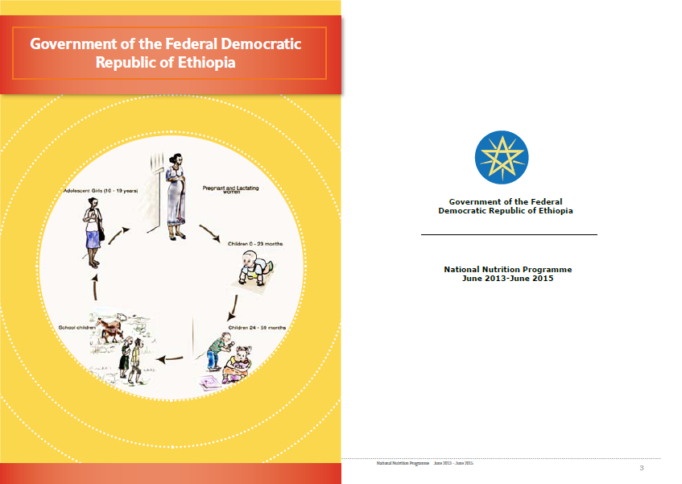

New NNP 2013 - 2015

Slide 49
Key challenges of the Implementation of the 2008–2013 NNP
  Missed opportunity
    Nutrition is not well reflected in some NNP implementing sectors’ strategies and programs
    The potential of these programs to improve nutrition has therefore not been sufficiently utilized
    The result is a critical missed opportunity to improve nutrition and complement successes both in these sectors and in exiting nutrition interventions.

Slide 50
  Limited intersectoral coordination
    Nationally, horizontal ministerial-level inter-sectoral coordination mechanisms are limited; at regional level, these are either inadequate or nonexistent. It has been difficult to create operational, effective linkages with relevant sectors at all levels
    Until recently, food fortification programs had not been given much attention, despite food fortification being one of the sustainable ways of doing micronutrient interventions.

Slide 51
  Inadequate integration
    Mechanisms for triangulated nutrition information that captures data from all relevant sectors (for use in improved program implementation and early warning) are inadequately integrated.
  Inadequate focus to gender mainstreaming
    Even if gender has been identified as a determining factor in achieving nutrition related objectives, programs were not designed based on gender analyses, and adequate structures and systems were not put in place to oversee gender mainstreaming and the building of human resource capacity for nutrition.

Slide 52
  Inadequate focus to life cycle approach (1000 days)
    Strategies for breaking the intergenerational cycle of malnutrition were neither focused nor complete, particularly in addressing the critical window of opportunities—the first 1,000 days. A strategic and logical scheme of activities to address chronic under-nutrition was lacking, as were focused interventions that would address nutrition in women and adolescents.

Slide 53
Rationale for Revision
The National Nutrition Program is revised to:
  1. Strategically address the nutrition problem in the country through
    Taking multisectoral and multidimensional nature of nutrition
    Focusing on life cycle approach to map key actions needed to improve the nutritional status of strategic target groups( women and children)

Slide 54
  2. Strengthen initiatives that were not adequately addressed in the 2008 NNP document and include initiatives that have emerged since the NNP was devised:
    Accelerated Stunting Reduction Initiative
    Strengthening the national food fortification program
    Strengthening of multi-sectoral linkages – key sectors include; Agriculture, Education, Water and Energy, Labour and Social affairs, Finance and Economic Development, Women Child and Youth Affairs
  3. Align the end of the first phase with the GTP, HSDP IV and MDGs, i.e. extend the first phase by 2 years to 2015

Slide 55
Strategic Objectives of the NNP
Strategic Objective 1
  Improve the nutritional status of women (15-49 years) and adolescents (10-15 years)
2015 Targets
  Reducing the proportion of adolescent girls aged 15 -19 with a BMI < 18.5 from 36% to 25%
  Reducing the prevalence of anemia among pregnant women from 22% to 12%

Slide 56
Strategic objective 2
  Improve the nutritional status of infants, young children and children under five
2015 Targets
  Increase the proportion of infants 0 – 6 months old who are exclusively breastfed from 52% to 70%
  Increase the proportion of breastfed children aged 6 – 23 months with the minimum acceptable dietary score from 4 to 20%
  Reduce the prevalence of Bitot’s spots in children aged 6 – 59 months from 1.7 to less than 0.5%

Slide 57
    Reduce the percentage of children 6 – 12 years old with median urinary iodine concentration of less than 100 ug/L to below 50%
    Increase the proportion of households using iodized salt from 15.4 to 95%
    Reduce the prevalence of anemia in children 6 – 59 months from 44% to 25%
    Increase zinc supplementation in the treatment of diarrhea from 5 to 50%
    Maintain coverage of VAS/deworming at over 90%

Slide 58
Strategic objective 3
  Improve the delivery of nutrition services for communicable and non communicable/ lifestyle related diseases (all age groups)
Target
  Nutrition and HIV
  Nutrition and Tuberculosis
  Nutrition and other infections
  Chronic non communicable diseases/lifestyle related diseases

Slide 59
Strategic objective 4
  Strengthen implementation of nutrition sensitive interventions across sectors
Targets
  Increase the proportion of households consuming fruits and vegetables by 30%
  Increase fruit and vegetable production from 894,000 (2011) tons to 5,905,000 tons by 2015 to improve food diversification at community level
  Increase potable water coverage from 60% to 76%
  Increase the proportion of primary schools with school gardening to 25%
  Increase the proportion of schools that provide biannual deworming to 60%

Slide 60
Strategic objective 5
  Improve multi-sectoral coordination and capacity to ensure NNP implementation
2015 Targets
  Increase the proportion of the health development army (HAD, Women) in the preparation of CF to 60%
  100% of nutrition sensitive sectors will integrate nutrition in their annual work plan in line with NNP
  100% of nutrition sensitive sector ministries will assign nutrition focal person for the sector
  Conduct five national nutrition coordinating body (NNCB) meetings (two meetings per year)
  100% of the regions will establish a regional nutrition coordinating body and technical committee

