Slide 1
ALN Training Dire Dawa

Slide 2
Advocacy, Lobbying and Negotiation skills on Disability Rights & Food Security
Training of Trainers (ToT)
By; Getnet Samuel
Diredawa Bloosom Hotel
Nov.08-12/2021

Slide 3
Welcome

Slide 4
Day one

Slide 5
Self Introduction;-
Name/Nick Name;
Marital Status;
Educational Background;
What he/she expect to get from the training;

Slide 6
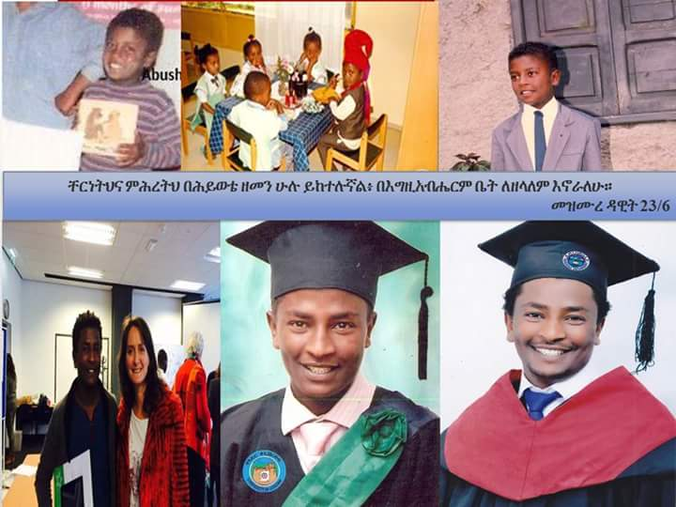

Slide 7
Training Methodology
Brainstorming
Group Work
Role play
Presentation
Discussion

Slide 8
Ground rules

Slide 9
Time Table
Morning :-
Tea Break :-
Lunch
Afternoon
Tea break
Day End

Slide 10
Executives
    Time Keeper
    Energizer
    Judge

Slide 11
Pre-Test
ALN Training Dire Dawa

Slide 12
Training Content
Module I: Networking
Lesson 1: Basics on networking
Lesson 2: Building a network
Lesson 3: Good governance of network
Lesson 4: Examples and practical application
Module II: Lobbying
Lesson 1: Basics on Lobbying
Lesson 2: Basic activities for effective lobbying
Module III: Advocacy
Lesson 1: Basics on advocacy
Lesson 2: Advocacy strategy
Lesson 3: Examples and practical application
Module IV: Negotiation
Lesson 1: Basics on Negotiation
Lesson 2: Negotiation Process
Lesson 3: Types of Negotiation
Lesson 4: Negotiating With Government and Other Bureaucracies

Slide 13
Lesson 1: Basics on networking

Slide 14
Brainstorm
Discus the underneath questions in your group and reflect your thoughts
  What does networking mean?
  What are the preconditions to establish a network?
  How many organizations should a single network consist?
  Whey do people/organizations need networking?
  What are the benefits of networking?
  What are the challenges and problems faced by networks?

Slide 15
Lesson 1: Basics on networking
Networking practices are probably as old as mankind
Networking is based on peoples’ need to take measures to “capitalize” on their social relations in order to deal with the challenges of life
Networking is about seeking multilateral co-operation with other persons or organizations.
The concept of networking is based on the will to co-operate and identify mutual interests.
The existence of a common goal brings partners together and reinforces the necessity to join forces in order to achieve the set goal

Slide 16
REASONS FOR NETWORKING
Networking mainly intends to cluster the provision of services, promote participatory learning and strengthen advocacy and management
Some good reasons for networking:
  Dissemination of information
  Dissemination of know-how
  Co-ordination of activities in terms of synergy
  Technical guidance and co-ordination
  Seek social well-being and social progress
  Make use of partners’ skills and resources and seek more specialization
  Stimulate competition in terms of bringing together resource

Slide 17
Lesson 2: Building a network
Before setting up a network a certain number of pre-conditions should be taken into consideration:
  Understand that a network is a means and not an end in itself
  Understand that networks are temporary creations
  Understand that networks are not built over-night
  Networks should be built on the basis of prior feasibility studies and a sound rational
  Networks need to rely on their own resources

Slide 18
Continued…
  Networks need diversity of membership
  Networks need flexible management and an ability to adapt over time to changing circumstances
  Networking needs formal basics
  Networks need solid anchors in local communities
  Networking is more important than networks’ formal structures

Slide 19
Four steps for setting a network
After having agreed on setting up a network, the following steps should be taken:
1. Decide on the coordinator and partners
2. Analyze the problems and define the objectives
  3. Determine the means to be used and the measures to be taken
  4. Plan the working model and set rules

Slide 20
Basic rules for good planning for networking
Networks should be planned in a participatory manner and not be dictated by the top
Planning should not only concentrate on the implementation of activities, but also on the development of the network itself
If needed, ask for the opinion and advice from outsiders
Clarify the role and contributions of partners and actors involved in the network
The added value of the network to the partner organizations needs to be identified

Slide 21
Size of networks
The size of a network depends on the aim and nature of the mission of the network
An average network consists of five to twenty partner organizations
In the case of a larger number of partners the common goal may be difficult to define
Networks can be enlarged after a first round of successful work/Experience
It is much easier to strengthen “old networks” or build on existing working relations, than to try and build a totally new network.

Slide 22
Working tools
Networks rely on communication skills and technologies. They operate through:
  The use of e-mail and telephone for daily communications
  The use of Internet or intranet based forums and other information systems
  Planning and holding numerous face-to-face meetings, crucial for a good understanding between network partners

Slide 23
Necessary skills and competences for successful networking
Successful networking demands from its coordinator(s) and its members a set of core competences and skills like:
      Communication skills
      Co-ordination skills
      Decision-making capacity
      Diplomacy
      Leadership skills
      Management skills
      Negotiation skills
      Persuasion competences
      Planning competences
      Analytical skills

Slide 24
Lesson 3:Good governance of network
Setting rules and defining the mode of operation of a network is crucial for its success
The definition of rules should be subject to a broad consultation among the partners
The following rules should be considered as guidelines for good governance in networking:
  Respect the partner’s culture and his way of working
  Be attentive and listen to each other
  Create a good and trustful atmosphere
  Action has to reflect the added value of the partnership

Slide 25
Continued…
  Make sure that decisions are taken in a democratic manner, everybody should participate
  Listen before acting and take the time to decide even under pressure
  Communicate regularly with the partners and always convey the aims and the results
  Prepare a schedule for all activities
  Constantly check if the commonly defined objectives are still valid and if all the partners still support them
  Handle financial procedures, simply, correctly and transparently
  Handle resources carefully and economically
  Avoid heavy bureaucracy

Slide 26
Common obstacles and weaknesses in networking
  Mismatch between partners and actors
  Mismatch between problem analysis and network definition
  Lack of resources, mostly in terms of time
  Lack of know-how on the process and functioning of networks
  Lack of common and clear goals
  Lack of confidence regarding the network’s influence and power

Slide 27
Examples and practical application
Example: - FENAPD – Federation of Ethiopian National Associations of Persons with Disabilities
Overall objectives:
  The ultimate goal of FENAPD is to improve the quality of the lives of persons with disabilities through active and effective intervention of its member DPOs.
Objectives:
  Developing the capacity of its member DPOs
  Maximizing the social disability awareness level
  Promoting inclusive education
  Promoting health HIV/AIDS services for persons with disabilities …

Slide 28
Continue…
Members:
Currently, FENAPD is a consortium of the following organizations:
  The Ethiopian National Association of the Blind (ENAB)
  The Ethiopian National Association of the Deaf (ENAD)
  The Ethiopian National Association of the Deaf-Blind (ENADB)
  The Ethiopian National Development Association of Persons with Physical Disabilities (ENDAPPD)
  The Fikir Ethiopia National Association on Intellectual Disability (FENAID)
  The Ethiopian National Association of Persons Affected by Leprosy (ENAPAL)
  The Ethiopian Women with Disabilities National Association (EWDNA)

Slide 29
Continue…
Activities and services:
  Capacity building,
  Awareness raising,
  Inclusive education
  HIV/AIDs/health
  Economic empowerment
  Resource mobilization,
  Conducting & supporting researches on disability,
  Women, children & youth development
  Environmental protection See Less

Slide 30
Continue…
Reasons for setting up the network:
  The federation is established with the intention to address the very severe disability problems and worst life situations of persons with disabilities in Ethiopia in more coordinated and collaborative manner.

Slide 31


Good old lessons in teamwork
from an age-old fable
The Tortoise
And
The Hare

Slide 32
Once upon a time a tortoise and a hare had an argument about who was faster.
That’s not true.
The fastest runner is
me!
I’m the fastest
runner.

Slide 33
They decided to settle the argument with a race. They agreed on a route and started off the race.
Fine!
Ok, let’s have
a race.

Slide 34



The hare shot ahead and ran briskly for some time. Then seeing that he was far ahead of the tortoise, he thought he'd sit under a tree for some time and relax before continuing the race.
Poor guy! Even if I take a nap, he could not catch up with me.

Slide 35

He sat under the tree and soon fell asleep.

Slide 36
The tortoise plodding on overtook him and soon finished the race, emerging as the undisputed champ.

Slide 37

The hare woke up and realized that he'd lost the race.

Slide 38
The moral of the story is that slow and steady wins the race.
This is the version of the story that we've all grown up with.

Slide 39
The story continues …

Slide 40

The hare was disappointed at losing the race and he did some soul-searching. He realized that he'd lost the race only because he had been overconfident, careless and lax. If he had not taken things for granted, there's no way the tortoise could have beaten him.
Why did I lose the race?

Slide 41
So he challenged the tortoise to another race. The tortoise agreed.
Ok.
Can we have
another race?

Slide 42

This time, the hare went all out and ran without stopping from start to finish. He won by several miles.

Slide 43
The moral of the story?
Fast and consistent will always beat the slow and steady. If you have two people in your organization, one slow, methodical and reliable, and the other fast and still reliable at what he does, the fast and reliable chap will consistently climb the organizational ladder faster than the slow, methodical chap.
It's good to be slow and steady; but it's better to be fast and reliable.

Slide 44
But the story doesn't end here …

Slide 45

The tortoise did some thinking this time, and realized that there's no way he can beat the hare in a race the way it was currently formatted.
How can I can win the hare?

Slide 46
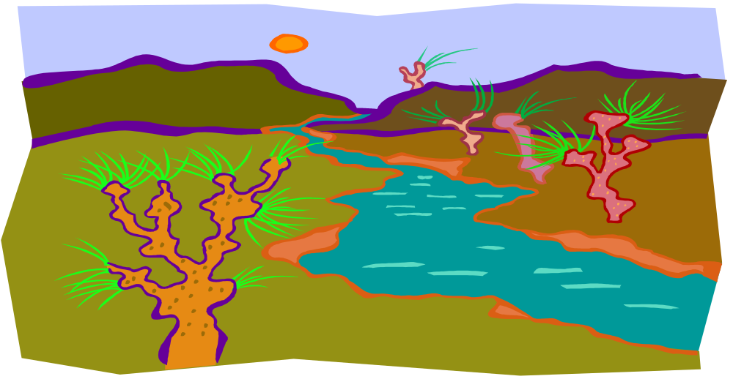
He thought for a while, and then challenged the hare to another race, but on a slightly different route.
The hare agreed.
Can we have another race? This time we’ll go through a different route.
Sure!

Slide 47

They started off. In keeping with his self-made commitment to be consistently fast, the hare took off and ran at top speed until he came to a broad river. The finishing line was a couple of kilometers on the other side of the river.
Goal

Slide 48


The hare sat there wondering what to do. In the meantime the tortoise trundled along, got into the river, swam to the opposite bank, continued walking and finished the race.
What should I do?

Slide 49
The moral of the story?
First identify your core competency and then change the playing field to suit your core competency.
In an organization, if you are a good speaker, make sure you create opportunities to give presentations that enable the senior management to notice you.
If your strength is analysis, make sure you do some sort of research, make a report and send it upstairs.
Working to your strengths will not only get you noticed, but will also create opportunities for growth and advancement.

Slide 50
The story still hasn't ended …

Slide 51
The hare and the tortoise, by this time, had become pretty good friends and they did some thinking together. Both realized that the last race could have been run much better.

Slide 52
So they decided to do the last race again, but to run as a team this time.
Great! I think we could do it much better, if we two help each other.
Hi, buddy. How
about doing our last
race again?
Hi, buddy. How
about doing our last
race again?

Slide 53

They started off, and this time the hare carried the tortoise till the riverbank.

Slide 54
There, the tortoise took over and swam across with the hare on his back.

Slide 55
On the opposite bank, the hare again carried the tortoise and they reached the finishing line together. They both felt a greater sense of satisfaction than they'd felt earlier.

Slide 56
The moral of the story?
It's good to be individually brilliant and to have strong core competencies; but unless you're able to work in a team and harness each other's core competencies, you'll always perform below par because there will always be situations at which you'll do poorly and someone else does well.
Teamwork is mainly about situational leadership, letting the person with the relevant core competency for a situation take leadership.

Slide 57
There are more lessons to be learnt from this story.
Note that neither the hare nor the tortoise gave up after failures. The hare decided to work harder and put in more effort after his failure. The tortoise changed his strategy because he was already working as hard as he could.
In life, when faced with failure, sometimes it is appropriate to work harder and put in more effort. Sometimes it is appropriate to change strategy and try something different. And sometimes it is appropriate to do both.
The hare and the tortoise also learnt another vital lesson. When we stop competing against a rival and instead start competing against the situation, we perform far better.

Slide 58
To sum up, the story of the hare and tortoise teaches us many things:
Never give up when faced with failure
Fast and consistent will always beat slow and steady
Work to your competencies
Compete against the situation, not against a rival.
Pooling resources and working as a team will always beat individual performers

Slide 59
Let’s go and build stronger teams!

Slide 60
Group Work
Simulation Exercises (Group Work)

Slide 61
Day two
Day one Recap

Slide 62
Module II: Lobbying
  What does lobbying mean?
  What is the importance of lobbying?
  Who is lobbyist?
  Why do people lobby?
  What is the difference between Lobbying and Advocacy

Slide 63
Basics on Lobbying
Lobbying refers to attempts to influence the decisions, actions, or policies of legislators or members of regulatory agencies
Lobbying may involve directly contacting or getting the public to contact the policymakers in order to support or oppose certain legislation.
It may also involve advocating the adoption or rejection of certain legislation.
Through lobbying interest groups try to influence legislation
Rules place limits on its methods of action, in an attempt to prevent political corruption
A lobbyist is a person who works professionally on influencing legislation

Slide 64
Civil society, lobbying, and good governance
Lobbying is recognized as a core activity of civil society in the policy making process and as an important element of participation
OPDs plays an important role in giving voice to the concerns of PWDs and the delivery of services that meet their needs
For example, educating an elected government official about the effects of a policy on your community is advocacy, but asking this government official to vote for or against a specific legislation is lobbying

Slide 65
Lesson 2:Basic activities for effective lobbying
In order to achieve effective lobbying the following actions should be accomplished:
  The monitoring and observation of political processes and developments, with special focus on those sectors that are relevant to the lobbyist’s or organization’s themes/fields of action
  The analysis of political processes and their potential impact on position taking
  Choose the most appropriate lobbying instruments
  Implementation of lobbying activities and presentation of one’s positions
  Widen the range of public relations (PR)
  Monitor and analyze the effects of lobbying activities
  Control of lobbying effects

Slide 66
"Inside" Lobbying
“Inside” Lobbying is a form of lobbying that takes place within the legislative bodies or institutions (National Parliament, Regional Parliament, etc.) through:
  Meetings with lawmakers and legislative staff
  Providing analysis and information to committees and legislative offices
  Testifying in committee’s consultations
  Negotiating with policy makers and other lobbying groups

Slide 67
"Outside" Lobbying
An effective lobbying campaign also requires activity outside the parliamentarian structures, aimed at shifting the politics and pressure around the issue
Some of these activities include:-
  Media activity including news conferences, editorial board visits, and assisting reporters with stories
  Local lobbying visits to legislators
  Building broad and diverse coalitions
  Letter writing campaigns to legislators
  Grass root activities such as rallies

Slide 68
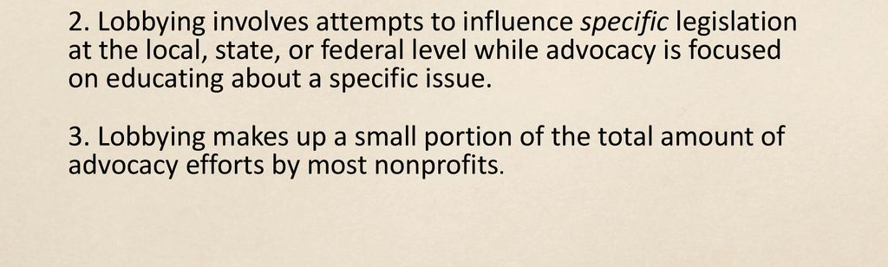

Slide 69
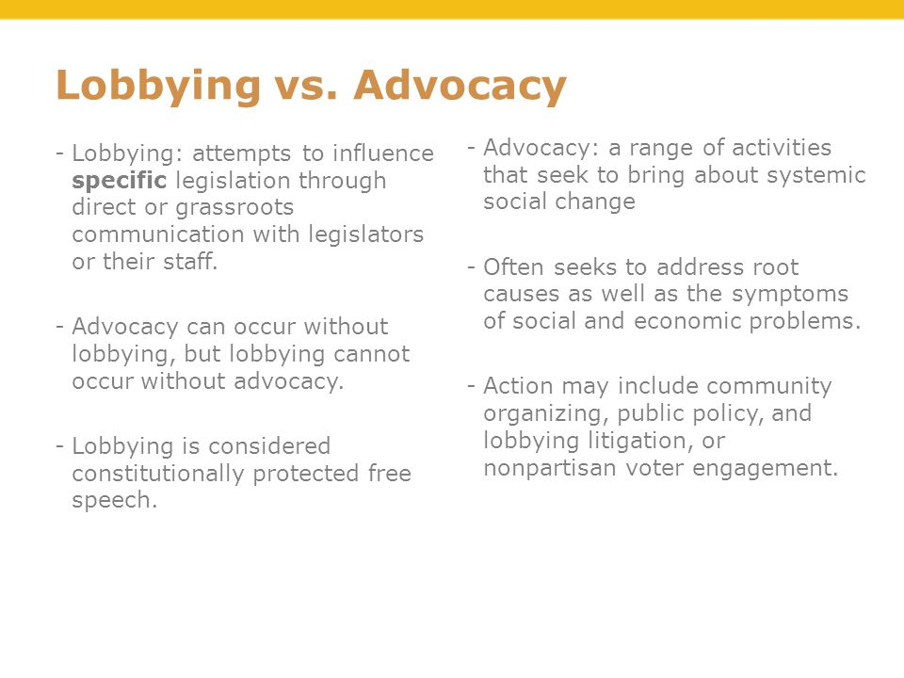

Slide 70
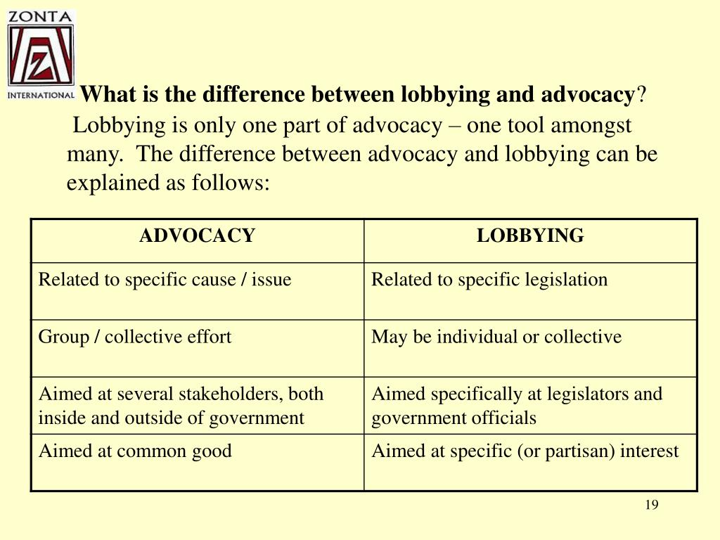

Slide 71
Group Work
Select one issue and show us how you approach and lobby legislators/government officials or other decision makers

Slide 72
Day Three
Day Two Recap

Slide 73
Module III: Advocacy
What's Advocacy?
What do we advocate?
Why we advocate?
What are the benefits of Advocacy?

Slide 74
Definition…
Advocacy ….‘The process of influencing key decision-makers and opinion-formers (individuals and organizations) for changes to policies and practices that will work in poor people’s favor.’
Advocacy: A combination of individual and social actions designed to gain political commitment, policy support, social acceptance and systems support for a particular health goal or program (WHO, 1998).

Slide 75
Definition…..
Advocacy is first and foremost a process
It is strategic and targets well-designed activities to key stakeholders and decision makers.
Advocacy is always directed at influencing policy, laws, regulations, programmes or decisions on funding made at the upper-most levels of public or private sector institutions.

Slide 76
Definition…
The common characteristics of advocacy, independent of the concrete definition of it, are:
  Advocacy works at policy level
  It aims to influence the creation/changes of policy and/or how policy is implemented
  The main targets of advocacy campaigns are policy makers and key decision makers (those in power)-more generally those that are in a position to influence actions that affect many people simultaneously

Slide 77
Advocacy …
Target audience
policy makers (those decision-makers with the authority to affect the advocacy objective)..on political or other social system position
Objective
change policies, programs, or the allocation of public resources
Measure of success
adoption of a new or more favorable policy/program; % shift in resource allocation; new line item in a public sector budget, etc.

Slide 78
Level of advocacy
Advocacy takes place at all levels of decision-making
Advocacy is needed at all levels because decisions at top levels affect those at lower levels
Actions at lower levels can determine policies at higher levels
Therefore, advocacy is necessary at all levels for lasting change

Slide 79
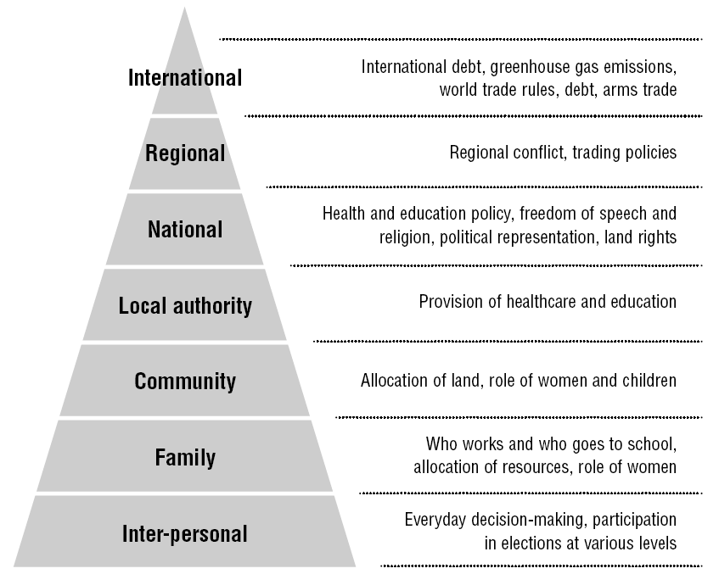
Levels…example

Slide 80
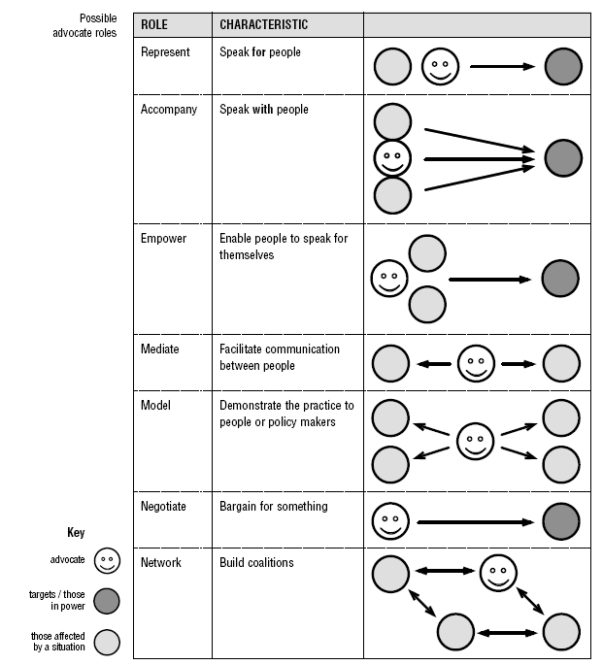
Roles of an advocate

Slide 81
Principles of advocacy
Advocacy is about achieving social justice (value)
Advocacy is about achieving equity (value)
All advocacy must attempt to minimize conflicts of interest
Always tell the truth
Know who is on your side
Know who is not on your side
Follow-up

Slide 82
Principle ….
Speak with clarity, transparency and credibility
Personalize your story and make emotional connections
Use scientific evidence and harmonious experiences
Engage in two-way communication with stakeholders
Integrate educational components and teaching moments
Advocacy is about achieving the best possible outcomes for all parties concerned. It is not affecting others !!! It is speak for justice and equity !!!

Slide 83
Advocacy planning process
1 Issue identification
2Research and analysis
3Planning
4Action
5Evaluation

Slide 84
Step one: Issue identification
The first step before any intervention is usually to identify the issue that needs to be addressed (FS/PWDs Right)
The issue may be quite obvious, however, sometimes it is not immediately clear and a community or group needs to go through a process of identifying their needs and the issues they want to address

Slide 85
Issue ……
How do you identifying needs/issue??
Set priority !!!
How !!!

Slide 86
Step two: Research and analysis
Collect information required to gain a deeper understanding of the issues identified in step 1 before undertaking any advocacy work
All advocacy work needs to be based on accurate, reliable and sufficient information.
Gather the necessary information and ensure that the causes and effects of the problem are understood.

Slide 87
Research….
Good information is important for advocacy in order to:
  Understand the context in which you work, including causes and effects of the particular issue
  Justify any particular course of action
  Learn from past successes and mistakes
  Provide good evidence for your argument
  Understand what others are doing, in order to avoid duplication and to collaborate if appropriate

Slide 88
Research…
1. Understanding the wider context
A. Force field analysis
Identify the different forces acting in society, either for good or bad, and to consider ways to make the most of the good forces and minimize the negative ones
It is helpful to think of the forces as political, economic, social and environmental
B. Drawing a timeline of key event
Similar to the force field analysis, but roots the understanding in a historical context
Identify key events that have influenced the country or area

Slide 89
Wider context …
C. Contextual analysis
Similar to the force field analysis but goes into much greater depth and deals with facts as well as trends, future , implication etc.

Slide 90
2. Understanding the root causes in your specific context
Identify the root causes of the problem in order to address the problem in the most appropriate way
The ‘why?’ exercise is a method that keeps asking ‘why?’ until it gets to the root of the problem
It makes the connection between the wider context and specific issues
Why exercise helps to develop problem tree
Keep asking …but why?

Slide 91
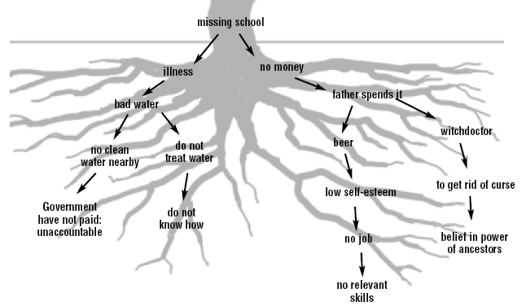
Root causes in problem tree (example)

Slide 92
Root causes …
Depth analysis of the root cause help to identify areas which need advocacy intervention
The problem tree can be extended to include the effects of the problem, which become the branches growing out of the tree

Slide 93
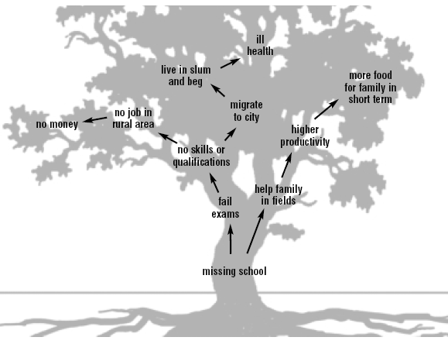
Effects in problem tree (example)

Slide 94
Effect…
This highlights areas for intervention to lessen the effects of the problem
This addresses the immediate needs until a lasting solution can be found

Slide 95
3. Desk-based research
All collected information may not be useful in advocacy
The best approach is to find a few sources that you trust and find easy to use
Some types of information or information sources may be seen by policy-makers and those in power as more trustworthy or more legitimate than others
Assessing information for bias and usefulness before using it for advocacy
    Eg. Govrnment Reports, Partners Report, University Researchs, ….etc

Slide 96
4. Deciding whether to advocate
Decide whether advocacy is an appropriate response to an issue and assess their own skills and resources
Is advocacy the best way to tackle this problem?

Slide 97
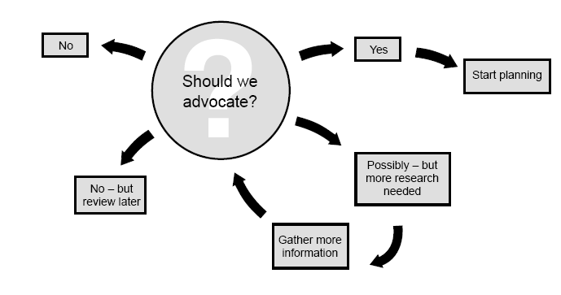
Deciding….

Slide 98
Step three: Planning
Planning includes the goal, objectives, success indicators, means of measurement, targets, allies, methods and activities, risks and assumptions, timescale and responsibilities

Slide 99
…planning is a strategic choice
Ask oneself the following questions for your strategic choice is important next to advocacy goal;
  What do you want? (Objective)
  Who can give it to you (Your audience)
  To whom do they listen? (correlates, influencers)
  Who can give it to them? (media/channel)
  What do they need to hear? (message)
  Who do they need it to hear from? (messenger)
  How can we get them to hear? (methods)
  So it entertain each!!!

Slide 100
1. Developing advocacy goal
The goal is the overall purpose of the project
The goal is long-term and gives direction
A goal often refers to the benefit that will be felt by those affected by an issue
Eg.
  To improve PWDs right
  To ensure food security
  To ensure that adequate budget will be allocated for malaria prevention

Slide 101
2. Set SMART advocacy objectives
An objective is the intended impact or effects of the work you are doing, the specific change that you want to see
The objective often refers to the desired changes in policy and practice that will contribute to that goal

Slide 102
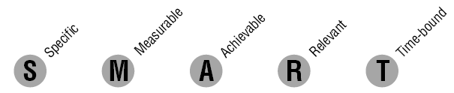
SMART objectives…
Eg
To increase the amount of budget allocated to PWDs rights and food security related activities by 20% in two years

Slide 103
Objectives…
Objectives can be long-term or short-term.
Short-term objectives may focus on smaller policy and practice change, attitude change by the target group or raising awareness
Long-term objectives usually focus on changing institutions’ policy or practice that affect the community
It may be necessary to achieve some of the short-term objectives before you can achieve the long-term ones

Slide 104
3. Setting indicators and means of measurement
Develop clear indicators to measure advocacy success
Once you have developed your objectives, the success indicators should follow logically
They are produced by asking: ‘How will I know if I have fulfilled my objectives?’

Slide 105
4. Stakeholder mapping and analysis
Before undertaking any advocacy work, it is important to identify whom you should be speaking to and whom you need to be working with
These people are commonly referred to as stakeholders because they have an interest or ‘stake’ in the issue
Know whom you want to influence and persuade and identifying how your opponents are framing the issue

Slide 106
Stakeholders…
Grouping or categorizing stakeholders :
GROUP 1: Those directly affected by the situation
GROUP 2: Those responsible for creating the situation or with formal responsibility for finding a solution(decision makers)
These are usually the targets of advocacy work, but may also be allies

Slide 107
Stakeholders…
GROUP 3: Those concerned for the welfare of others and other interested groups, such as NGOs, church groups, media
These are potential allies, and may also be targets
GROUP 4 :International players, such as donors, UN bodies, NGOs
These can be targets, allies or opponents.

Slide 108
Day Four
Day Three Recap

Slide 109
Stakeholder analysis….
Once you have mapped your main stakeholders, assess their level of interest and positions they are going to take,
You can draw up a stakeholder analysis table to understand:
How much each group agrees with your position – you can score them on a scale of -3(strong disagreement) to +3 (total agreement), with a score of 0 meaning undecided

Slide 110
Stakeholder analysis….
How important the issue is to them (on a scale of L=low, M=medium and H=high priority)
What level of influence they have (on a scale of L=low, M=medium and H=high).

Slide 111
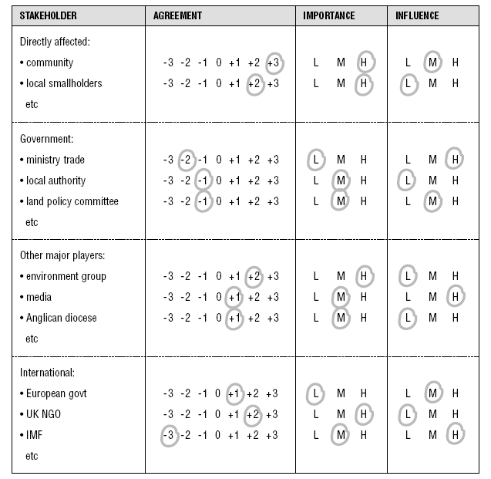
Stakeholder analysis table

Slide 112
Allies and opponents matrix
It may be useful to represent the findings of the stakeholder analysis table in a more diagrammatic form to see at a glance who are your opponents and allies are
Opponents will be to the left, allies to the right of the central line

Slide 113
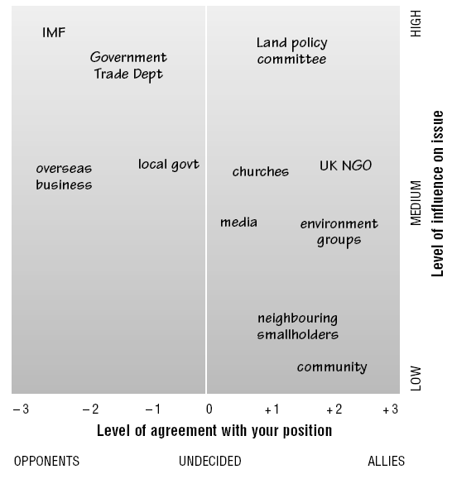
Allies and opponents matrix…

Slide 114
Stakeholder analysis ….
This can help you target your time and resources towards the most useful contacts.
It will help you to avoid putting all of your effort into working with those who are in strong agreement but who have no influence, or
Working with those for whom the issue is low priority and so are unlikely to give much time to it

Slide 115
5. Choosing advocacy methods
There are many methods and activities that can be used to carry out advocacy
It is likely that you will use most of them at various stages of the advocacy process
The activities you choose will be determined by your objectives, skills and resources and targets

Slide 116
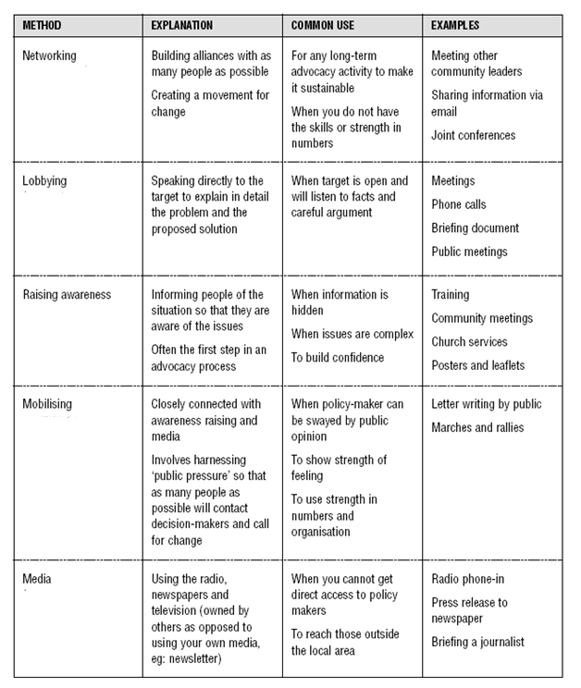
Advocacy methods…

Slide 117
6. Risk management
Advocacy involves risk; therefore making sure that you consider the main risks you face before you undertake advocacy, and planning ways of reducing these risks
Eg.
  Damaged reputation
  Violence against those doing the advocacy and their friends and family, and against those being advocated for.
  Psychological abuse against all those involved
  Economic loss such as loss of a job
  List the main areas of risk and agree the methods and activities you will use to reduce the risk and who is responsible for this, the ‘owner’.

Slide 118
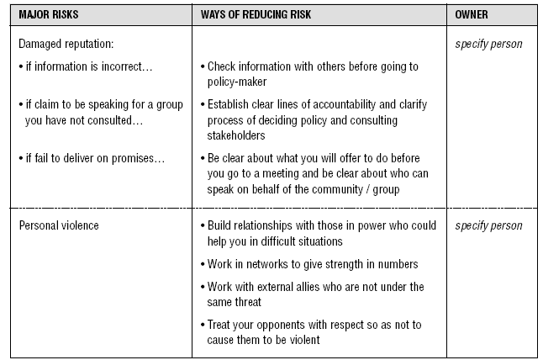
Risk management…

Slide 119
Risk management….
If you think any risk is too high, it is wise to consider using other options for your advocacy, such as using an external spokesperson or overseas NGO
There may be some situations where the risk is so high that you cannot do any advocacy at all
Ensure that everyone involved is aware of the risk, is still happy to proceed and is aware of what to do to minimize the risk

Slide 120
SWOT analysis
SWOT analysis is a simple way of looking in more detail at your strengths and weaknesses, and considering how to build on your strengths and eliminate your weaknesses, concentrating particularly on the first two rows

Slide 121
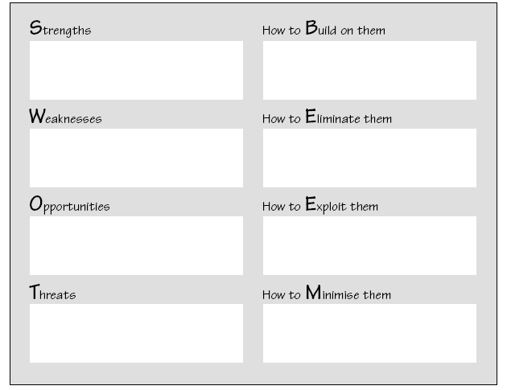
SWOT…

Slide 122
7. Action planning/produce plan of work
Once you have developed an overall advocacy strategy with clear ideas of methods and activities, it is important to plan how it will take place in terms of timing, resources, budgeting, personnel, etc.
Decide;
    who will do what, when will this be done, and with whom, what types of inputs, besides people, will be needed.
    These things can be done using an activity planning and an activity schedule (Gantt chart).

Slide 123
Action plan…activity
Objective | Indicator | How to measure success | Target | Allice | Methods & activity | Material | Personnel needed | Risk/assumptions | Responsibility | Date | Cost

Slide 124
Activity schedule (Gantt chart)
Place all of the activities into a time frame so that you can all plan your work together
All the advocacy activities now need to be incorporated into one time-frame
The chart shows when each activity is due to start and finish

Slide 125
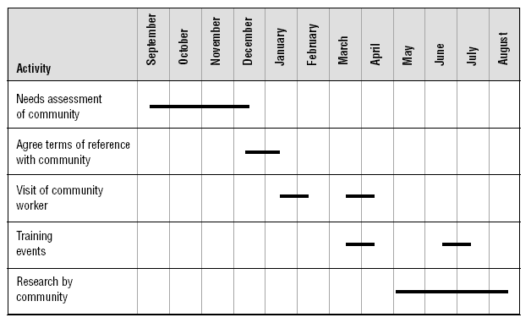
Sample Gantt chart

Slide 126
Step Four: Action/implementation
In this step, advocacy strategies are converted into action
A lot of option is there to conduct advocacy
You may use all of the options in a particular advocacy initiative
It is vital that all activities are coordinated and that they do not contradict each other

Slide 127
Advocacy options
Deciding your position /message
Networking
Lobbying
Education and raising awareness
Mobilizing
Working with the media

Slide 128
1. Deciding your position
A position is a statement of what an organization, group or person believes about a particular issue and how they think this should be acted upon
Position is often also called a policy.

Slide 129
Purposes of Positions
Clarify thinking on a particular issue : It is often only when things are written down that the position becomes clear
Accurate representation: being able to give a position to other groups such as the media and policy-makers will help you to be accurately represented and understood by them
Consistency of voice : to ensure that all spokespeople within the group give the same messages

Slide 130
Position …
Clarify differences: to help you to identify the main areas of disagreement you have with other people’s positions and therefore clarify the main areas for advocacy work

Slide 131
Positions …tips
Positions should be kept as brief as possible (2–4 pages) and to the point
Focus on what you can offer, such as new or unique evidence that you might have
Make sure information is relevant and up-to-date
Build arguments around what you believe to be the weak points of the policy-makers.

Slide 132
Positions ….
Policy-makers need to know they can work with you, so ensure that the tone of the position shows that you are willing to co-operate
Write clear recommendations that can be implemented
Ensure that your position accurately reflects the views of those you claim to represent
Check for grammar and spelling mistakes – poor presentation can discourage people from reading it

Slide 133
Main components of a position or policy
Introduction: Name of organization, what your main activities are, what your basis for existence is, who you represent
Executive summary (if the position paper is long). Brief outline of your history of involvement, of the issues and why you are concerned
Effects and evidence : What are the current and potential future effects of the issue on those you represent? Include any primary or secondary research you have.

Slide 134
Main components…
4. Causes and responsibility:
  Which groups or individuals have caused the current situation and are responsible for it?
  What events have contributed towards it?
  Why have particular actions been wrong, according to law, morality, etc?

Slide 135
Main components…
5. Solutions and recommendations
  What needs to be done to address the problem?
  Who is responsible for doing this?
  What is already happening to address the issue and who is doing this?
  Make sure these are SMART
6. Appendices : Include any detailed information that you have referred to in the main document.

Slide 136
How position present to policy makers??
Positions can be sent or given to policy makers in one of three main forms:
  a short position paper: 2–4 sides, handed over at a visit or sent with an accompanying letter highlighting key points, or the recommendations)
  a longer briefing document (handed over at a visit or sent with an accompanying letter highlighting the main points)
  a letter written for a specific policy-maker, which includes the main points from a position paper. This acts as a stand-alone document, but offer to provide more details if required.

Slide 137
2. Networking
Networking is making links from people we know to people they know, in an organized way, for a specific purpose, while remaining committed to doing our part, expecting nothing in return
Networking is about making contact with people and organizations for the purposes of sharing information and possibly working together for greater effectiveness.

Slide 138
Networking…
This can be done informally, such as through individual relationships or sending information that might be of interest, or
It can be done more formally through joining or forming a network that can help them to promote issues and causes that they are involved in, on behalf of the public good.

Slide 139
Networking …
In networking with other groups it is useful to ask the following questions:
  Who shares your values?
  Who is already working on the issue?
  Who can provide something that you need?
  Who would co-operate with you?
  Who has the capacity to act?
  Would things be worse if you did not work together?

Slide 140
3. Lobbying
Means “directly influence decision-makers or politicians/government, for example, to support or oppose changes in law”
Persuading politicians/decision makers to take a course of action that you support
The ultimate aim of much of our advocacy work is to influence decision-makers,
There are a number of possible approaches, including: writing a letter or sending a position paper, making a phone-call, arranging a visit or a public meeting or conference, taking the opportunities that arise, such as a chance meeting, using court

Slide 141
Types of lobbying
Policy change:
This is the most common lobbying activity, which is aimed at all types of decision-makers who have policies and practices that affect communities.
Changing legislation:
This type of lobbying activity aims at political representatives who are involved in making and passing laws.
This lobbying is technical and involves suggesting specific amendments to existing laws, content for new laws or arguing to maintain laws that others are seeking to abolish.

Slide 142
Lobbying …
Using the courts:
This involves trying to ensure that legislation is correctly implemented, rather than changing legislation.
This is a more specific approach, which usually requires experienced lawyers
The process can be time consuming and expensive, but if the actions are clearly illegal and the court implements the rule of law, then success is likely.

Slide 143
Lobbying …
Human rights
Human rights are a set of rights that have been agreed at international level
They are based on the understanding that everyone has equal worth and that everyone has a responsibility to treat others with dignity and respect
They shouldn’t be violated and if violate advocate to enforce law . Eg. FGM

Slide 144
4.Education and raising awareness
Education and raising awareness are activities that are central to advocacy activity in order to empower people to act on new information and understanding.
Usually at the beginning of advocacy process
Methods:
  Public meetings and rallies
  Print media: newspaper, articles, posters, press releases
  electronic media etc.

Slide 145
5. Mobilizing people for action
Mobilizing people for action, once they are aware of the issues and convinced of the need for action
There are two types of groups that can be mobilized for action:
  Those who are directly affected by the problem (PWDs)
  Those who are concerned for others, such as NGOs

Slide 146
Importance of mobilizing groups of people for action
It brings greater pressure to decision-makers through showing there is public concern, a wide range of interested groups, and a high level of awareness and understanding.
It adds legitimacy to lobbying efforts when the affected community come together to show their concern
It can open access to decision-makers if lobbying is not achieving much
It is a way of using energy or anger in a positive way that will bring about change
It can bring media attention and raise the profile of the issue

Slide 147
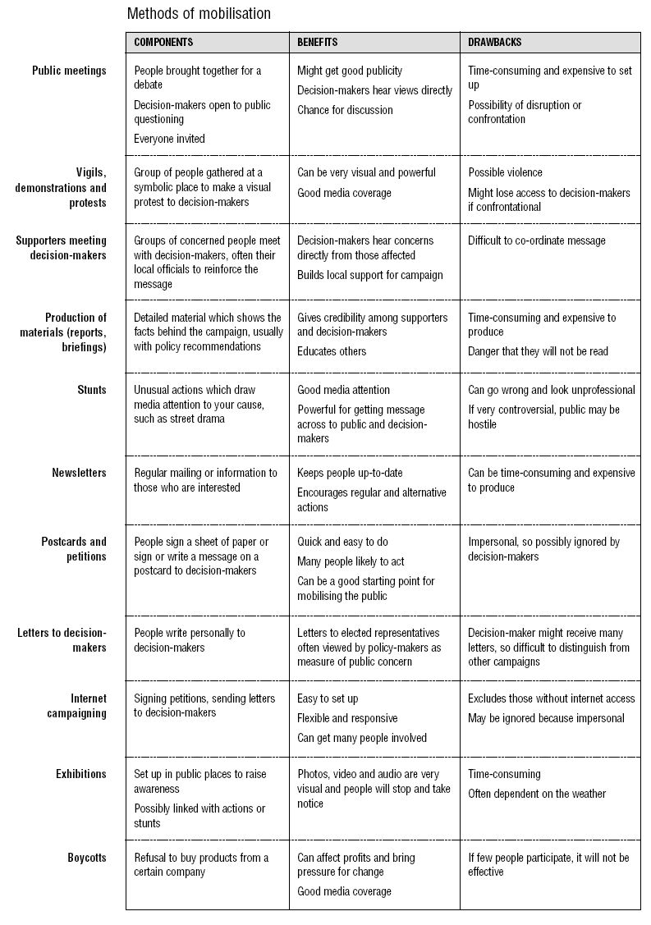

Slide 148
6. Working with the media
‘Media’ includes radio, television, newspapers, magazines and the electronic media such as email and the internet
It is a powerful force that can build awareness and shape public opinion and influence policy decisions
The most commonly used methods with media;
  Press release/News release
  Press conference
  Radio/TV interview

Slide 149
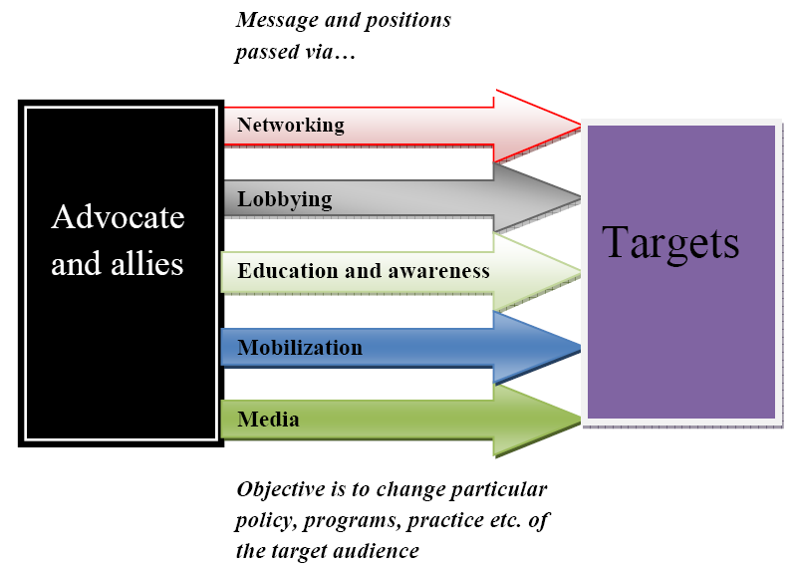

Slide 150
Step Five: Evaluation and monitoring
Advocacy initiative should be evaluated to see whether the objectives are being achieved, and whether any changes need to be made to the advocacy strategy.
Advocacy activities should be continually monitored to show whether they are being implemented as planned.

Slide 151
Reasons for monitoring and evaluation
Checking whether advocacy work is on track and determining whether any changes need to be made to the strategy
Checking whether the objectives have been achieved
Learning for future advocacy initiatives
Accountability to community members who might want to know what you have said and done in their name
Accountability to donors for use of funds

Slide 152
Monitoring advocacy activities
Monitoring is a way of checking that you are doing what you said you were doing, and identifying and addressing problems as they arise.
It helps you to understand success or failure of your advocacy strategy.
For monitoring you simply go through each of the activities in the Activity Planning

Slide 153
Monitoring …
Monitoring answers the questions:
Have we done the things we said we were going to do?
If not, why not?
What activities do we need to change to get the strategy back on track?

Slide 154
Evaluating advocacy activities
Evaluation is more complicated than monitoring.
It assesses the impact of a project,
Finds out whether objectives are still realistic and worth aiming for,
Gives credit for success to various factors or people and helps with accountability.
If you have SMART objectives and clear indicators and means of measurement, then evaluation will be a lot easier.

Slide 155
Evaluation…
Evaluation answers the questions:
  Have we achieved our objectives?
  If not, why not?
  What needs to change in the strategy as a result?

Slide 156
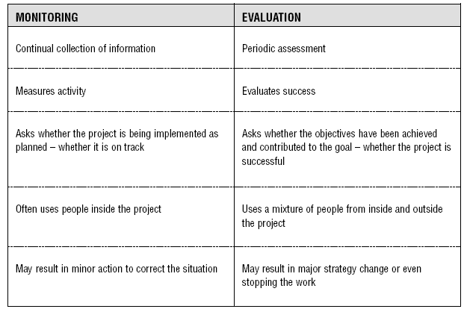
Differences between monitoring and evaluation

Slide 157
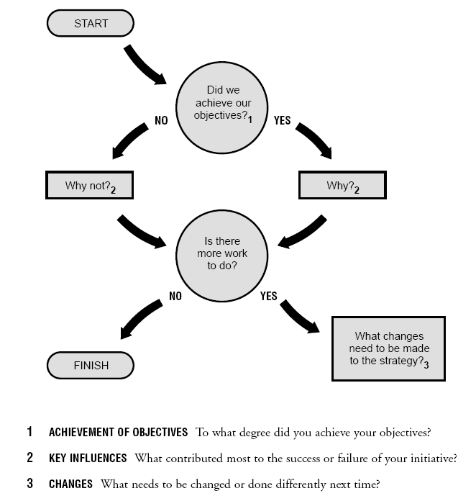
Procedure for evaluation

Slide 158
What to do with evaluation result?
In terms of ongoing advocacy, there are three main options:
Keep going with the strategy.
Modify your approach based on the evaluation.
Stop this particular initiative and learn from your mistakes next time.

Slide 159
Learning review
After any action, whether it is a visit to a decision-maker or a whole advocacy strategy, it is useful to undertake a learning review
This is a participatory evaluation of a piece of work in order to learn basic lessons for the next time you carry out a similar activity.
During review identify what went well (reasons for success) and what did not go well (reasons for failures) and use the lesson for next time.

Slide 160
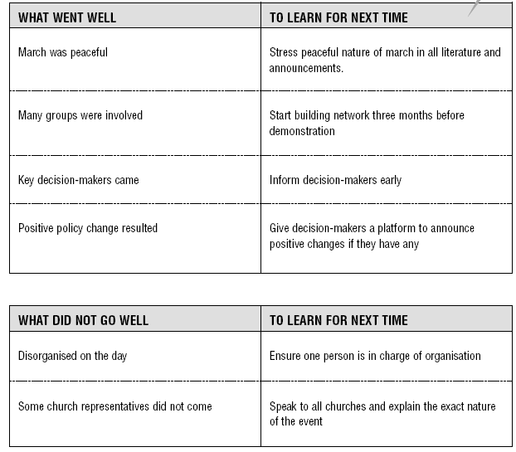
Example: mobilizing a community for a mass demonstration

Slide 161
Advocacy Example and practical application

Slide 162
SIMULATION EXERCISES- PRACTICAL APPLICATIONS (Group Work)

Slide 163
Day Five
Day Four Recap

Slide 164
Negotiation

Slide 165
Brainstorm (Group Work)
What is negotiation?
Why do people negotiate?
What are the benefits of negotiation?

Slide 166
Introduction…
“You need to become a skilled negotiator in order to accomplish your bigger-picture goals, such as
    forming and maintaining healthy personal and business relationships,
    achieving outstanding business results, and
    advancing your career.”

Slide 167
Introduction…
The negotiation:
  recognize many times each day you have to negotiate and influence others.
  In doing so, treat these as opportunities to
    advance your personal goals,
    help your business prosper, and
    build stronger supportive relationships in a widening business and professional network.

Slide 168
Negotiation defined
The Process of exchange
The Process to determine the exchange of tangibles and intangibles
Negotiation is usually considered as a compromise to settle an argument or issue to benefit ourselves as much as possible.

Slide 169
Negotiation…
A Process in which two or more parties
    Exchange Goods or Services and
    Attempt to Agree upon the exchange rate for them

Slide 170
Negotiation…
Negotiation is the daily give-and-take of social interactions
Once your eyes and ears are tuned to the language of negotiation, you realize that everybody negotiates constantly—all day long.

Slide 171
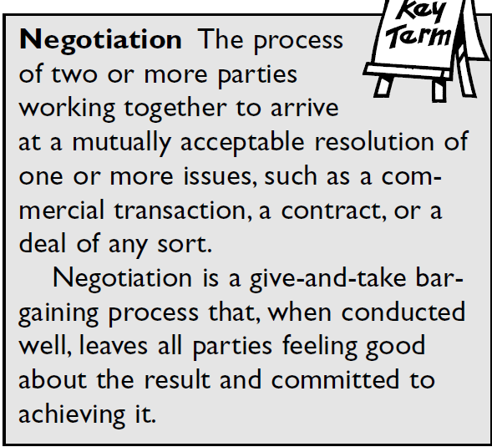

Slide 172
Negotiation…
A successful negotiation has taken place when the parties end up mutually committed to fulfilling the agreement they have reached.

Slide 173
Negotiation…
Fairness is a crucial element to make a negotiation process succeed
Some people negotiate as if their most significant objective is to take advantage of other parties; this is self defeating

Slide 174
Negotiation…
If any party feels unfairly treated, he or she may walk away from the negotiation with a negative feeling and a disinclination to live up to the agreement.

Slide 175
Negotiation…
In modern times, the aim of negotiation should focus on creative collaboration, rather than traditional confrontation, or a winner-takes-all result.

Slide 176
Negotiation…
Communication is always the link that will be used to negotiate the issue/argument
  face-to-face, on the telephone or in writing.
Remember, negotiation is not always between two people
  it can involve several members from two parties.

Slide 177
When Does a Negotiation Take Place?
Two conditions must be present for negotiation to take place.
  First, you have to identify a need, what you want to get out of the negotiation.
  Second, you have to involve some person or persons to fulfill your need.

Slide 178
Case 1
Balcha hadn't been feeling well, so he went to see his doctor. The doctor gave him a prescription and told him to call for a stronger prescription if his condition persisted. It does, so Balcha puts a call in to his doctor.

Slide 179
Case 1…
Four days later, Balcha gets a bill for 450 birr from his doctor. He's very upset about it, having paid 850 birr for an office visit already. He calls the office in the hope that the bill was an oversight.

Slide 180
Case 1…
“The bill is correct,” the nurse says coldly. “That is the doctor's standard fee for a phone consultation.”
Balcha is angry. But he takes no for an answer.

Slide 181
Case 2
Kiros is head of a WrHO. In the last 2 years he has noticed that budget allocated to the district health activities has been insufficient.
So he went to the WA to request for additional money to improve availability of essential drugs at the PHCUs in the district.

Slide 182
Case 2…
The WA emphasized that the amount allocated to overall district activities was minimal. He added, “it I just impossible to obtain some more money to the health sector.”
Kiros was not convinced but he took no for an answer.

Slide 183
No and the Negotiator
Too many of us are frightened away by the terrible omnipotence of the word “no.”
We were brought up to be terrified of it and to accept the unalterable finality of it.

Slide 184
No and the Negotiator…
Contrary to what we've been conditioned to believe, no is an opening negotiating position.
The good negotiator won't take no for an answer.
The good negotiator is always on the lookout for ways to get around it.

Slide 185
Negotiation Process: 5 Steps
  Preparation and Planning
  Define Ground Rules
  Clarify and Justify
  Bargain and Problem Solve
  Close and Implement

Slide 186
Negotiation Process…
Prepare and Plan (Pre-Negotiation)
    Before you decide to negotiate, it is a good idea to prepare.
    What is it exactly that you want to negotiate?
      Set out your objectives (Goals)

Slide 187
Negotiation Process…
Prepare and Plan…
  Nature of Conflict & History
    Who Is Involved
    What is involved (money, sales, time, conditions, discounts, etc)?
  You have to take into account how it will benefit the other party by offering some sort of reward or incentive.

Slide 188
Negotiation Process…
Prepare and Plan…
  Know your extremes: how much extra can you afford to give to settle an agreement?
  Although you are not aiming to give out the maximum, it is worth knowing so that you will not go out of your limits.

Slide 189
Negotiation Process…
Know what your opponent is trying to achieve by their negotiation.
  This is useful information that could be used to your benefit and may well be used to reach a final agreement.
Consider what is valuable to your business, not the costs.
  You may end up losing something in the negotiation that is more valuable to your business than money.

Slide 190
Negotiation Process…
Define Ground Rules
    Who
    Where
    When
    How
    Time
    Rules
    Issues
    Initial Proposal

Slide 191
Negotiation Process…
Clarify and Justify
  State Original Demands (Requests, Interests)
    Clarify
    Magnify
    Justify
  Identify their Wants, Needs, Goals, Interests

Slide 192
Negotiation Process…
Bargain and Problem Solve
  The Gives and Takes
  Begin with positive proposal
    Make SOME compromise
    Look for Reciprocity
  Address Problems (Issues) NOT Personalities

Slide 193
Negotiation Process…
Bargain…
  Pay little attention to 1st offer
  Emphasize win/win
  Create Open, Trusting Climate
  Ask Questions
  Focus your argument
  Minimize defensiveness

Slide 194
Negotiation Process…
Close and Implement
  Close
  AGREE ON AGREEMENTS
  Implement

Slide 195
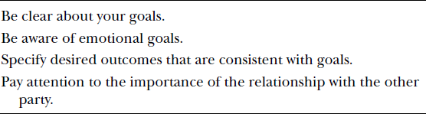
The four main concerns

Slide 196
Interests
In most negotiations, focusing on interests will make an enormous difference in the outcome.
Your interest is the answer to the question, “Why do you want (a particular result)?”
  If we agree to do that, what goal of yours will it satisfy?

Slide 197
Interests…
We must give thought to the interests of our constituents: the company, our family, or members of our team at work.
  Which interests of those constituencies are primary and which are secondary?
  How do those interests influence the approach we take in a given negotiation?

Slide 198
Interests…
Knowing that other groups have a stake in the outcome of our negotiation helps
  put things in context,
  gives us a broader perspective, and
  increases the likelihood that we’ll reach an agreement that comports well with the interests of our constituents.

Slide 199
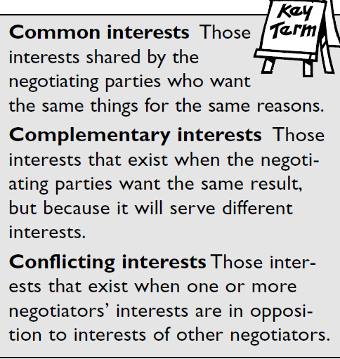
The Three C’s of Interests

Slide 200
Interests…
BATNA
  A party’s BATNA is its Best Alternative To a Negotiated Agreement.
  Your BATNA is not your bottom line.

Slide 201
Interests…
It is a measure of the balance of power among the negotiating parties based on the resources they control or can influence to respond to their interests that will be addressed in a given negotiation.

Slide 202
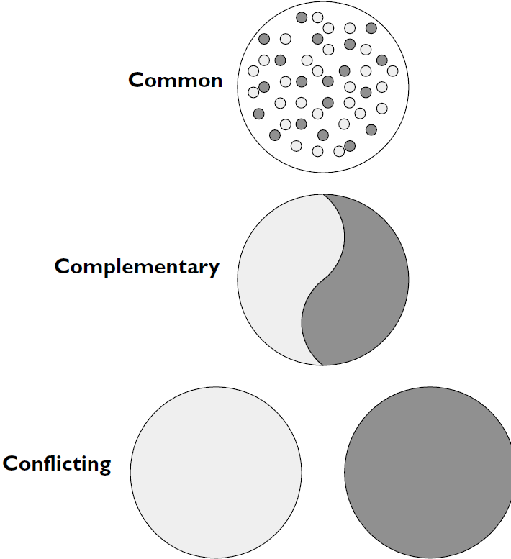
The Three C’s of Interests

Slide 203
Types of Negotiation
Distributive negotiation
  your reason for negotiation is seen as 'beating' the opposition,
  you must be prepared to use persuasive tactics
  your agreement is not being directed to a certain compromise
  both parties are looking for a different outcome.

Slide 204
Types of Negotiation…
Integrative negotiation
  your negotiation is much more 'friendly' with both parties aiming to reach agreement
  Usually brings an outcome where you will both benefit highly.

Slide 205
Distributive Vs. Integrative Bargaining
Distributive (confrontational)
  Short Term
  A zero-sum game
  I Win, You Lose
  Fixed amount of resources to be divided
Integrative (cooperative)
  Long Term
  build long-term mutually beneficial relationships
  I Win, You Win
  Variable amount of resources to be divided

Slide 206
Types of Negotiation…
If you are negotiating with someone who comes up with an outrageous or nacceptable proposal, rather than trying to convince him by yelling even louder, it can be extremely effective to respond with silence.

Slide 207
Principled Negotiations
Separate the people from the problem
Focus on Interests, Not Positions
Invent options for Mutual Gain
Use Objective Criteria
Decide on issues based on their merit

Slide 208
Separate the People From the Problem
Relationship Vs. Substance
Perception:
  Identify With Them
  Discuss Differing Perceptions
  Encourage Mutual Participation
Emotions
  Let off Steam
  Recognize Emotions
Communication
Prevention: Build Relationships

Slide 209
Invent Options for Mutual Gain
Brainstorm
Refrain From Judging
Broaden Options
Identify Shared Interests
Soften Differing Interests
See the Other Side
Win/win

Slide 210
Negotiating With Government and Other Bureaucracies
When you try to negotiate with a governmental agency, they won’t want to talk to you. Why? B/s
  You make waves,
  You want exceptions and special attention, and,
  In any case, what you want will require more work for them, which is the last thing they want to do.

Slide 211
Negotiating With Government…
Some tricks to keep in mind:
  Often an agency will tell you there's a policy against what you want.
  Force them to give you the policy and read it carefully;
  many times it's not what they said it was or there are loopholes or ways to get around it.
  Use their own policies against them.

Slide 212
Negotiating With Government…
Remember, no matter what they say, virtually no policy is so sacred that it can't be waived or adjusted to meet your needs.

Slide 213
Negotiating With Government…
If they give you a hard time, go to the top rather than the middle, and start your friend, the ripple effect, in motion, so that by the time that ripple reaches the agency or bureaucrat you are trying to negotiate with, they're at least going to have to give you a hearing, rather than refusing to deal with you.

Slide 214
Negotiating With Government…
Pump office clerks and others for information
One of the biggest problems is finding the right person to negotiate with.
  Don't start making your demands until you are sure you're dealing with the right person.
Be aware that governmental agencies operate in the public eye and are extremely sensitive to media attention on their shortcomings.

Slide 215
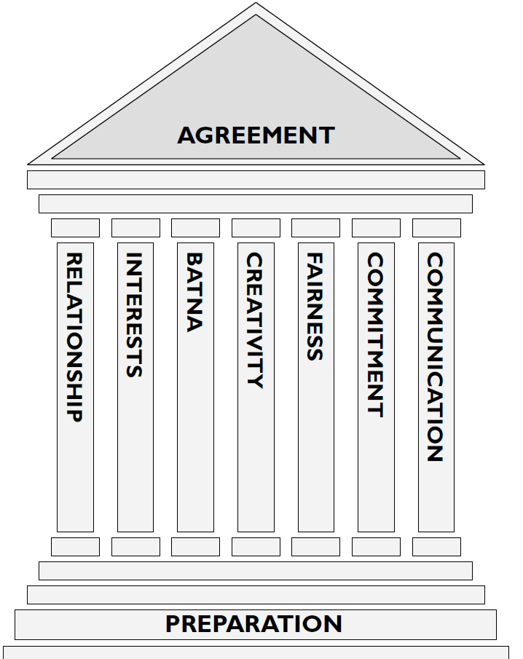
The Seven Pillars of Negotiation Wisdom

Slide 216

Thank You

