Slide 1






Training on Lobby and Advocacy,
We are Able! Programme, South Sudan
We are able! Co-creating inclusive governance for access to basic resources that leaves no one behind.
27-29 January 2022

Slide 2


outline
What have we learned from our past advocacy campaigns and lobbying processes?
What is advocacy and the advocacy building blocks?
How do we do Strategic Stakeholder Analysis and Power Mapping?
Notes:
DAY ONE MORNING SESSION
Session Objective: To improve our knowledge of what advocacy is – and isn’t – so that we can have better advocacy outcomes

Slide 3
Outline (cont)
How do we design an impactful Advocacy Campaign?
What is the secret to developing Impactful Campaign Messages?
Designing our Advocacy Campaigns (Group Work)
Ensuring that our Campaigns and Advocacy Work is Accessible for Everyone
Sharing South Sudan Disability Inclusion Good Practice (Interactive Session)
Notes:
DAY ONE MORNING SESSION
Session Objective: To improve our knowledge of what advocacy is – and isn’t – so that we can have better advocacy outcomes

Slide 4
What do we know?
Interactive discussion on some of our past advocacy campaigns and lobbying processes over the past five years (30minutes)
Participants share their lobbying and advocacy experiences
Notes:
30minutes

Slide 5
Past experience
What was the Campaign About?
What problem did we want to address?
What was our Campaign Objective (SMART)?
What was your Campaign Message/Ask?
Who was our Target Audience?
Which organisation led the Campaign?
Who supported/participated in the Campaign?
What were the main Activities?
Which Communication Tools did you use?
What was the outcome/impact?

Slide 6
What is advocacy?
ADVOCACY
Activism
Lobbying
Educate

Slide 7
What is advocacy?
Advocacy is to bring attention to an injustice.
An advocate speaks on behalf of a person, group or an organisation.
An activist is someone that takes intentional action to bring about change, typically social or political.
A lobbyist meets with lawmakers to write new laws or change existing laws.
An educator creates a deeper understanding about the issue we are advocating about.

Slide 8
What is advocacy?
A deliberate process of influencing those who make decisions;
Making a case in favour of a cause and getting others to support that cause;
Seeking to raise awareness among decision-makers and the public at the same time, if possible, so that policy and attitude change reinforce each other;
A tool to help us push for developments, reforms and/or implementation of policies;
A way of supporting or enhancing programme strategies for solving problems or making changes

Slide 9
What is advocacy?
Advocacy ultimately is about the art of persuasion.
Impactful advocacy speaks to "hearts, minds and hands".
It makes people care about the issue, understand the facts and know what they can do to help.
Advocacy, therefore, is not just about how much you know about your topic (mind), but also about how good you are in winning over and influencing people (heart), ending with being able to inspire them to get involved (hands)

Slide 10
ADVOCACY AND EXPERTISE?
Does an advocate need to be an expert?
Does an activist need to be an expert?
Does an educator need to be an expert?
Does a lobbyist need to be an expert?
What if we do not have the necessary expertise on our advocacy topic?
Expertise and Self-Representation

Slide 11
ADVOCACY BUILDING BLOCKS
1. Prioritise our issues
2. Research the issue
3. Analyse the political power and risks
4. Build professional relationships in the issue area
5. Learn the relevant political and government processes.
6. Develop an "ask" (campaign message or policy proposal).
7. Meet with officials and policymakers.

Slide 12
Where do we find information?
Our Lived Experiences; Our Stories
Facts and Figures (statistics) – our own surveys and databases; official statistics
Case Studies
Country Reports
Shadow/Parallel Reports
Juris Prudence (court judgements)
Political & Governance Systems (policies, departmental reports, speeches etc)

Slide 13
STAKEHOLDER ANALYSIS
Who are our allies/partners in South Sudan?
What is power mapping and why is it important?
How do we do a strategic stakeholder analysis?

Slide 14
Who are our allies/ partners in South Sudan?
Which NGOs are we currently working with/could we be working with?
Which other civil society institutions are we/could we be working with?
Which UN agencies are we currently working with/could we be working with?
Which government officials are we currently working with/could we be working with? (name, title, department)
What is the nature of our relationship?

Slide 15
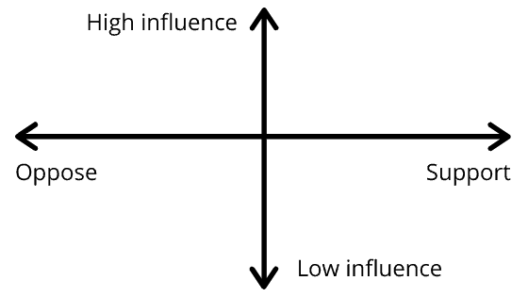
stakeholder power and risk analysis
Power mapping is an old practice that helps analyse power around an issue. It makes use of a simple graph like the one below.

Slide 16
Analysing influence
Persons/Institutions with High Influence who support/oppose the Rights of Persons with Disabilities/Disability Inclusion Agenda
  Do they have access to decision-makers/our primary target audience?
  Do they know someone who has access to decision-makers/our primary target audience?
  Does their opinion/advocacy carry weight where it matters?
  Do they have easy access to the media?

Slide 17
GROUP EXERCISE
Identify your key stakeholders
Analyse their potential influence
Maximise the influence of those with High Support Influence
Manage the risk of those with high opposition influence
Who are the stakeholders traditionally left behind?

Slide 18
DESIGNING IMPACTFUL ADVOCACY CAMPAIGNS
The Secret of Smart Campaign Messages
The Steps for and Impactful, Targeted Advocacy Campaign
Designing 3 local and national campaigns

Slide 19
CRAFTING OUR MESSAGE
Problem Statement: What do we want to change?
Expected Outcome (Goal): What do we want to achieve?
Target Audience: Who has the power and authority to change the situation?
Heart Message: Make them care about your issue/win them over
Mind Message: Help them to understand the facts/situation and how their action can change the situation
Hand Message (Our ASK): What action do we want from them/ how can they help?

Slide 20
CraftING a Smart
Campaign Message
Open with a dramatic fact – catch the attention
Describe the problem you want to solve – offer solutions if appropriate
Provide facts and data that are relevant to your audience
Share a story/case study
Connect with your audience’s values, self-interest and conscience
Show the benefits for your audience’s reputation
Make your request (the ‘ask’) – clearly indicate what you want the person to do

Slide 21
CAMPAIGN DESIGN STEPS
Decide on the Purpose and Focus of your Campaign
Do your Research (gather the facts and context documents)
Conduct a Strategic Stakeholder Analysis
Establish a Campaign Committee
Identify your ‘Ask’ (who is your target and what action do you want from them)
Key messages
Design Campaign Materials
Launch your Campaign
NB Remember ACCESSIBILITY!

Slide 22
ACTION PLAN
Realistic targets
Simple messaging
Clear actions
Clear responsibilities
Timelines
Accessible campaign materials
Effective Coordination
Accountability mechanisms
ACTION

Slide 23
Disability inclusive food security
The availability, accessibility and affordability of food to all the citizens of the country at all times.
What are the South Sudan Government Food Security Laws, Policies, Programmes and Services?
Which International Agencies support the South Sudan government with Food Security Services?
Which national and local NGO’s support food security?
Are we as persons with disabilities only consumers of food (recipients) or are we also producers of food? Where else in the food security value chain can we play a role, e.g. transporting, distributing, packaging, processing?

Slide 24
Disability inclusive emergency response
What are the South Sudan Government Emergency Response Laws, Policies, Programmes and Services?
Which International Agencies support the South Sudan government with Emergency Response Services?
Which national and local NGO’s support Emergency Responses?
Are persons with disabilities only recipients of emergency response services or can we also play a role in rendering emergency response services?
IASC Guidelines, Inclusion of Persons with Disabilities

Slide 25
Access to Assistive Devices
& Technology
What are the South Sudan Government Assistive Devices and Technology Laws, Policies, Programmes and Services?
Which International Agencies support the South Sudan government with Assistive Devices Services?
Which national and local NGO’s support provision of assistive technology and devices?
Are we as persons with disabilities only consumers of assistive technology and devices (recipients) or are we also producers/repairers/suppliers of these devices?

Slide 26
GROUPS : STEP 1
What is the problem you want to solve?
Decide on the Purpose of your Campaign
Do your Research (gather the facts and context documents)

Slide 27

GROUPS : STEP 2
Conduct a Strategic Stakeholder Analysis
Identify who your strategic partners are (explain why)
Identify who your primary target is and what action do you want from them (Who has the power and authority to change the situation?)
Identify those with high influence who support you
Identify those with high influence who oppose you

Slide 28
GROUPS : STEP 3
What is your Heart Message? Make them care about your issue/win them over
What is your Mind Message? Help them to understand the facts/situation and how their action can change the situation
What is your Hand Message? (Our ASK): What action do we want from them/ how can they help?
Now design your campaign message using the above

Slide 29
GROUPS : STEP 4
ACTION | RESPONSIBILITY | TIMELINE | BUDGET

Slide 30
Ensuring that our Campaigns and Advocacy Work is Accessible for Everyone
Language
Document Format
Video Closed Captions
South Sudan Sign Language
Accessible and safe venues
Accessible and safe transport

Slide 31
LANGUAGE
Use plain language and short sentences
Use people-first language (child with…)
Use camel case for multi-word hashtags #YouCanReadThisEasier
Remember to also make Easy Read versions with graphics and short sentences available for persons with intellectual disabilities

Slide 32
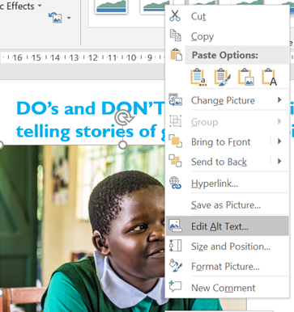
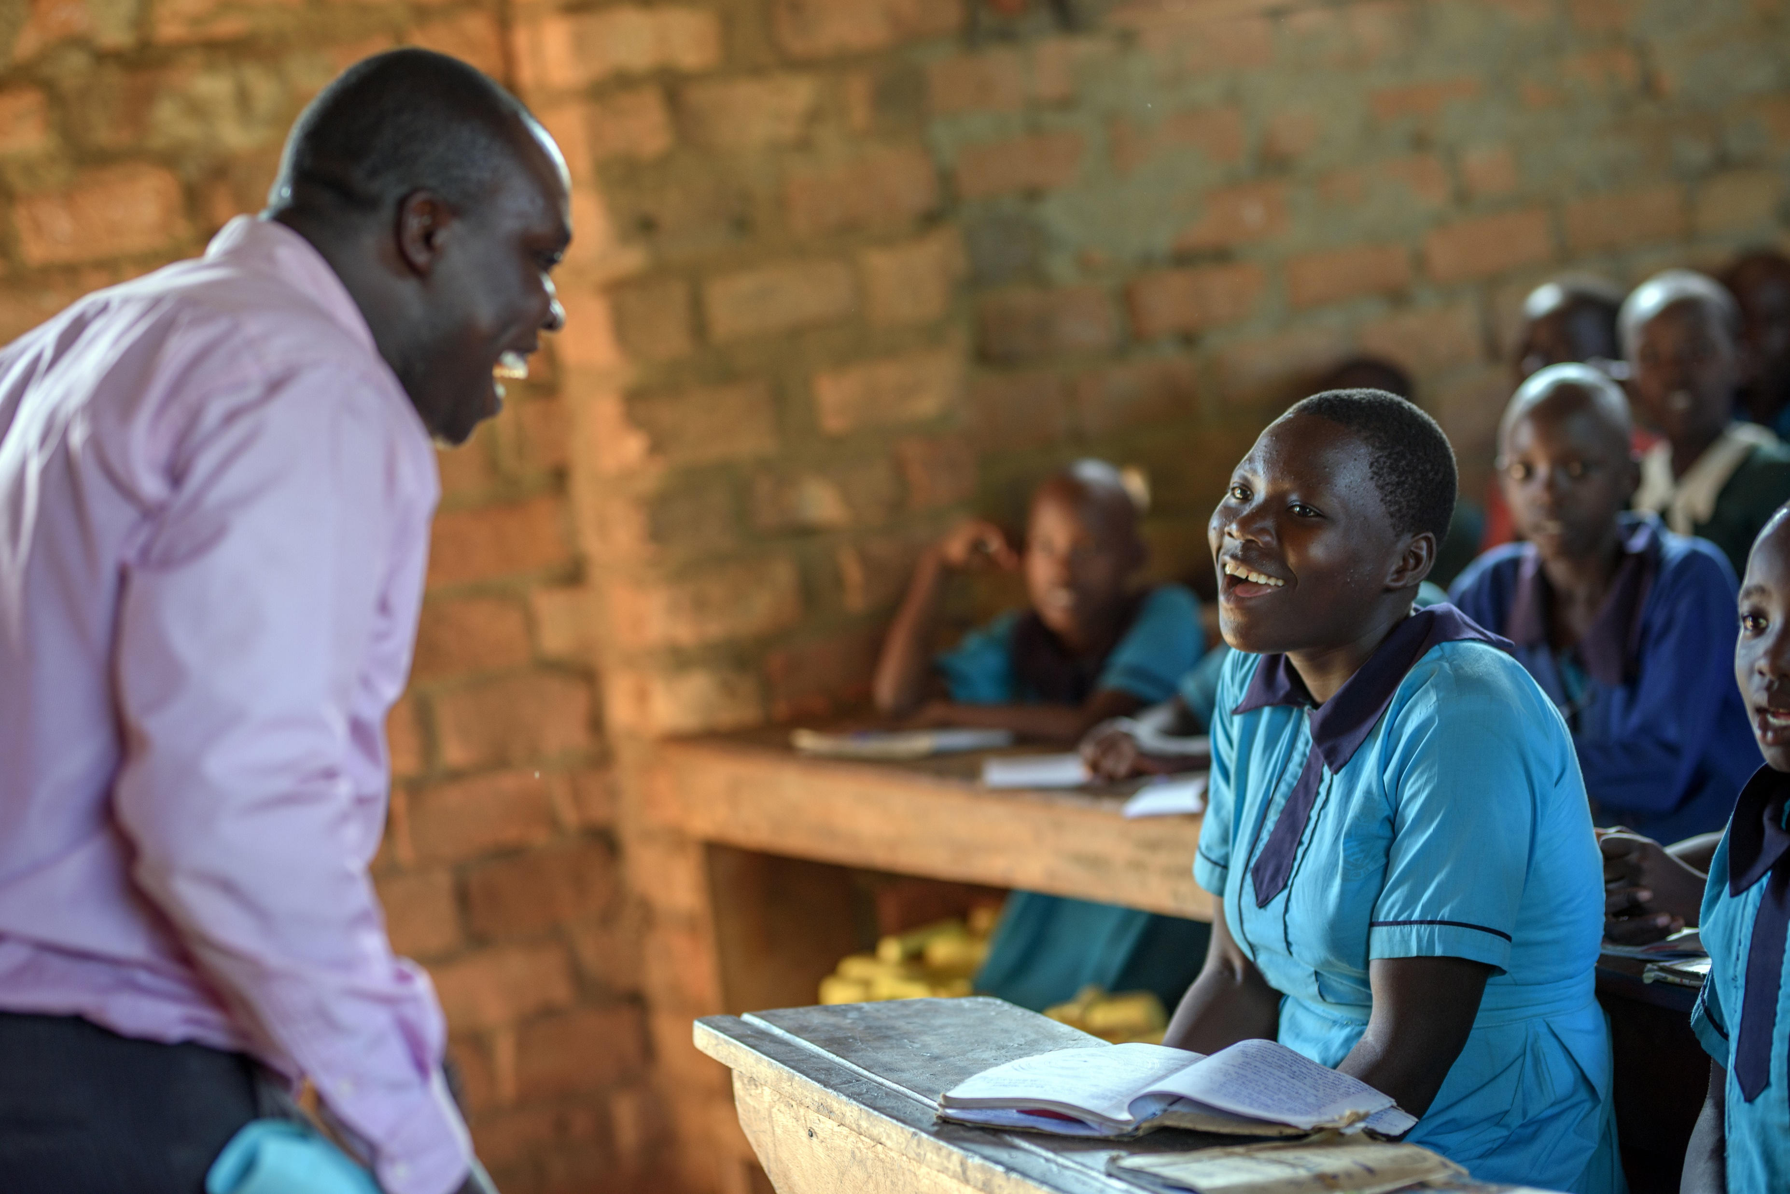




DOCUMENT FORMAT
For most persons with print disabilities
(blind people, people with low vision, people who have dyslexia (difficulty with reading and writing)
Include descriptions on photos (for context and screen readers)(Alt text function key)
Limit emoji and emoticon use
Don’t embed text in your images
Teacher and learner laughing

Slide 33


VIDEOS
Include captions and sign language translation on videos
Provide text and/or sign language transcripts of radio content

Slide 34
SIGN LANGUAGE
Make sure the interpreters are familiar with all the local sign language dialects and spoken languages that might be used at an event.
Always have at least two interpreters who can change over every 20min
Make sure interpreters wear clothes that make their hand signs easily visible

Slide 35

VENUES & TRANSPORT
DIGNITY
SAFETY

Slide 36
What did we learn?

Slide 37
What must we action?

