Slide 1


APROGRAMME FOR TRAINING PARTNERS IN DISABILITY AWARENESS AND DISABILITY INCLUSION.
Disability inclusive programming
By
Betty Najjemba
African Disability Forum (ADF)

Slide 2
Group Work
In a group of 5 participants.
Draw a project programme cycle showing your organization work- drawing example on any project which seems relevant.
Identify any project cycle process/ space in which you can involve persons with disabilities
Identify models/ approaches of inclusion you can apply to make it disability inclusive.

Slide 3
What Inclusive programming is …
CRPD-based inclusive programming is programming that proactively
seeks to understand and explore the implications and responsibility of
a project or program to advance the rights of persons with disabilities.
In line with Articles 4.3 and 32 of the CRPD, it entails ensuring
meaningful engagement of OPDs across the project cycle, from design
stage to budgeting, from implementation to monitoring and evaluating
project impact.

Slide 4
Unique role of Organizations of Persons with Disabilities (OPDs) as representative organizations
The CRPD sets a unique role for OPDs as key intermediaries partners to represent and channel the views and perspectives of persons with disabilities as set in Art. 4.3 and 33.3.
OPDs play diverse roles, including representing the concerns of persons with disabilities, providing peer support, facilitating access to information and services (sometimes even delivering services), providing technical guidance on the rights of persons with disabilities.
OPD participation brings multiple benefits for the relevance, quality, impact and sustainability of development and humanitarian work.
It promotes ownership of interventions, accountability and empowerment for OPDs to be long-term and efficient partners and counterparts.

Slide 5
OPD participation as an afterthought
More often than not, OPDs are not part of the design, and planning, implementation and monitoring of development programs.
When OPDs do not participate in a program’s design, the preconditions for their full and effective participation are not fulfilled, which not only affects their participation in the project but also leads to gaps in project implementation and relevance to persons with disabilities.

Slide 6
Absence of OPDs and lack of capacity within OPDs
This speaks to the marginalization and barriers that persons with disabilities have faced and continue to face, which has kept them from coming together as organized groups to collectively represent their issues.
Leaving persons with disabilities out because there are no OPDs to work with accelerate this cycle of exclusion.
In such contexts, it is important to engage with individual persons with disabilities as an alternative while exploring ways to support movement building.
lack of capacity where OPDs usually have limited capacities due to a number of reasons including being less or not funded at all

Slide 7
Lack of data on OPD participation
Generally, a lack of disaggregated data both on the prevalence of disability and on the extent and quality of participation of persons with disabilities impacts on participation, particularly from underrepresented groups.
Even where data is available, this is often collected through national tools that are based on a medical model of disability and may significantly miss discriminations and other barriers experienced by the diversity of persons with disabilities
Participation of OPDs needs to be measured throughout and push for disability disaggregated data or rather support the government to have such in place

Slide 8
Training of all staff on inclusive programming
Inclusive programming focuses on the processes and how to ensure meaningful engagement of OPDs across all processes within the project cycle.
It requires organizations to have policies and systems in place that identify and address barriers that impede meaningful participation.
It is important that the core principles of inclusion and participation are impated from the leadership to the operational staff within the organization.

Slide 9
Cont…
Limited understanding of accessibility and reasonable accommodation
Budgeting for meaningful engagement of OPDs

Slide 10
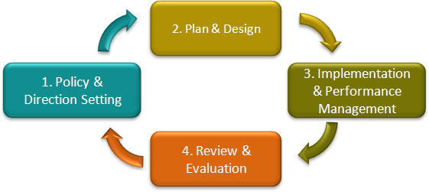
In conclusion

